Slide 1
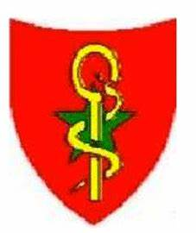

Effective military-civilian partnerships in malaria control in Senegal
Dr. Major. Mame Cheikh SECK
Professor of Parasitology
Senegalese armed forces

Slide 2
Armed Forces Health service Structure
Administration
Health facilities
Ministry of the Armed Forces
Army Force Health Service
(AFHS)
Level 4 hospital (1)
Level 3 hospital (1)
Level 1 hospital (3)
CENTRAL
Garrison Medical Center
(GMC)
REGION
Garrison medical Center (GMC) (11)
Army Medical Center
(AMC)
DEPARTEMENTAL
Army Medical Center (04)
Military Health Post (MHP)
COMMUNAUTY
Military Health Post (18)

Slide 3
Colloboration between NMCP and Armed Forces
Training of military medical staff
  Malaria case management
  Malaria microscopic diagnosis
Malaria case management supplies
Monitoring & evaluation

Slide 4
Training
Prompt and case correct management
Medical doctors, nurses and midwives of militaries facilities are trained in malaria case management by the NMCP
  Medical Chief officer of Garrison Medical Center are included in training sessions for Medical Chief district
  Chief nurses and midwives of GMC are included in training sessions of their civilians colleagues

Slide 5
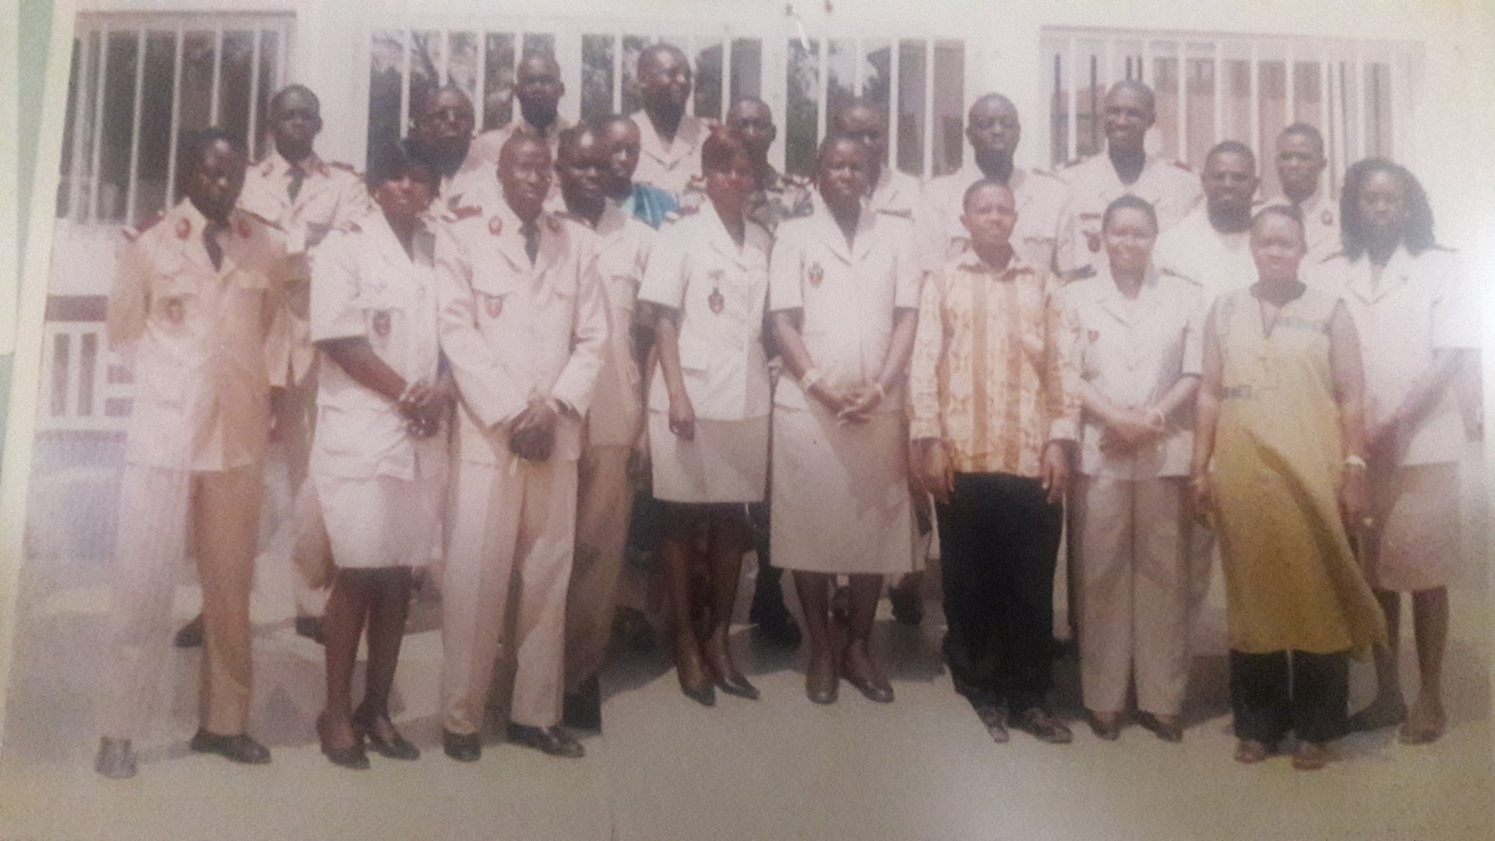
Training workshop for military medical doctors in malaria management:
Thiés-Sénégal July 2009

Slide 6
Training workshop for military Nurses and Midwives in malaria management:
Thiés-Senegal August 2022

Slide 7
Training
Malaria microscopic diagnosis
Military laboratory technicians are included in training sessions in malaria microscopic diagnosis by the NMCP
  In 2016: 02 training workshop were organized for all military laboratory technicians (22)
  In 2018: 04 sessions including military technicians were organized (14)

Slide 8
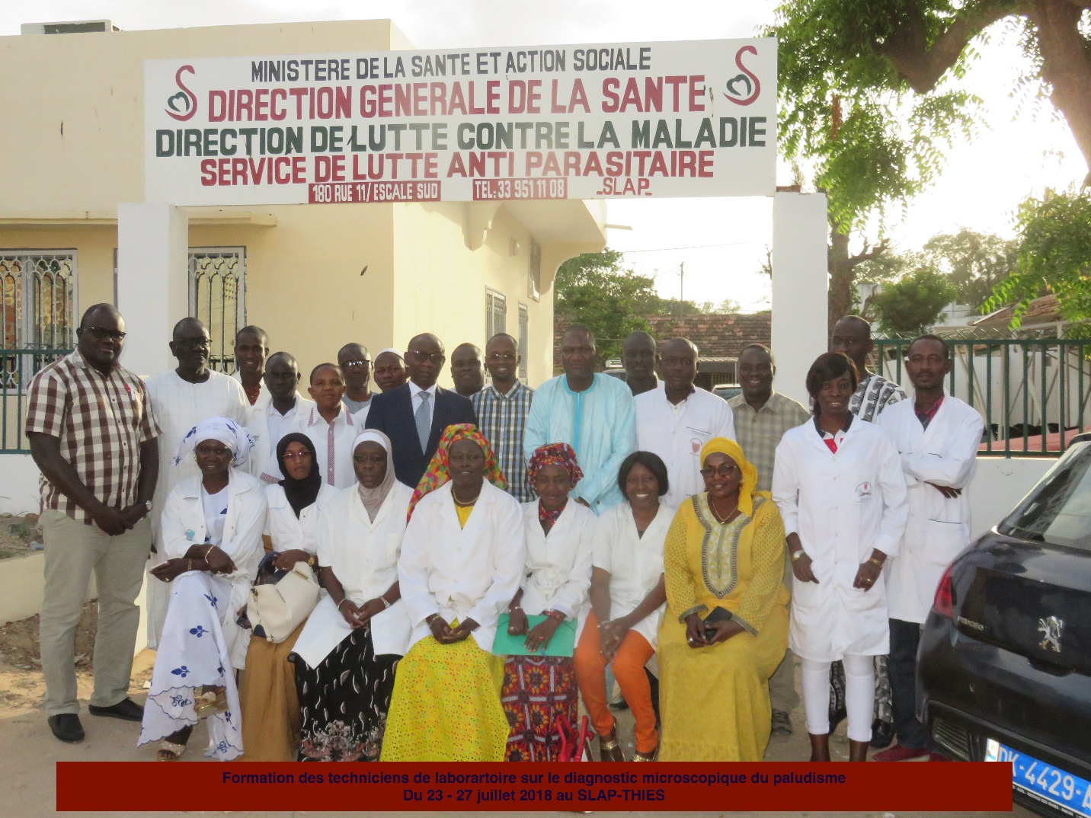
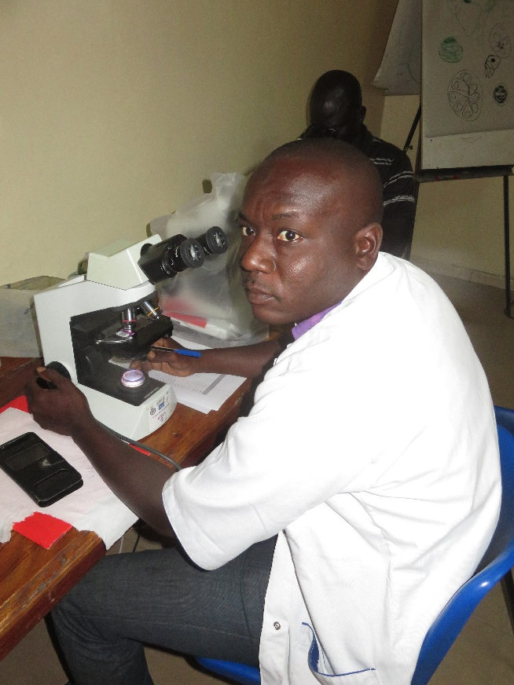
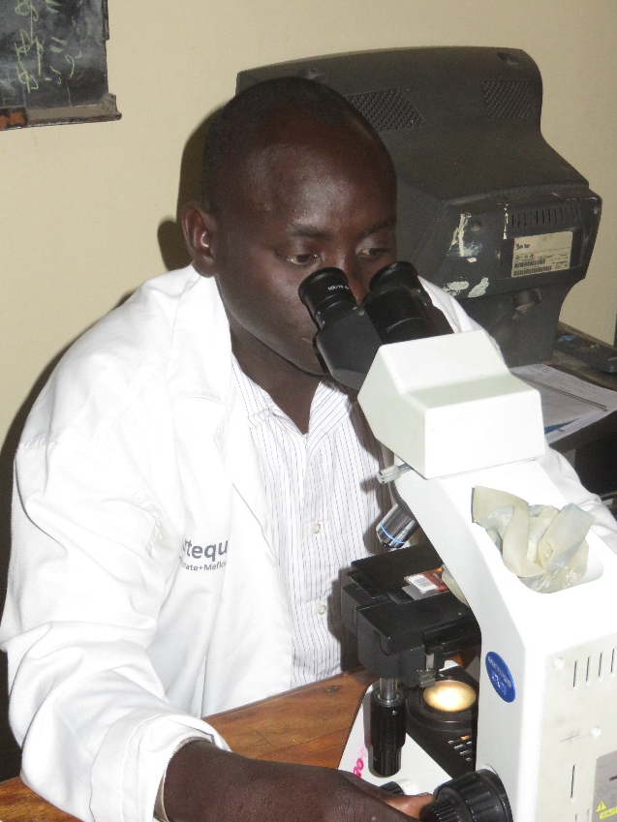
Training
Malaria microscopic diagnosis
Sergent Maiga
Sergent Diatta
Workshop: Malaria microscopic diagnosis, Thies-2018

Slide 9
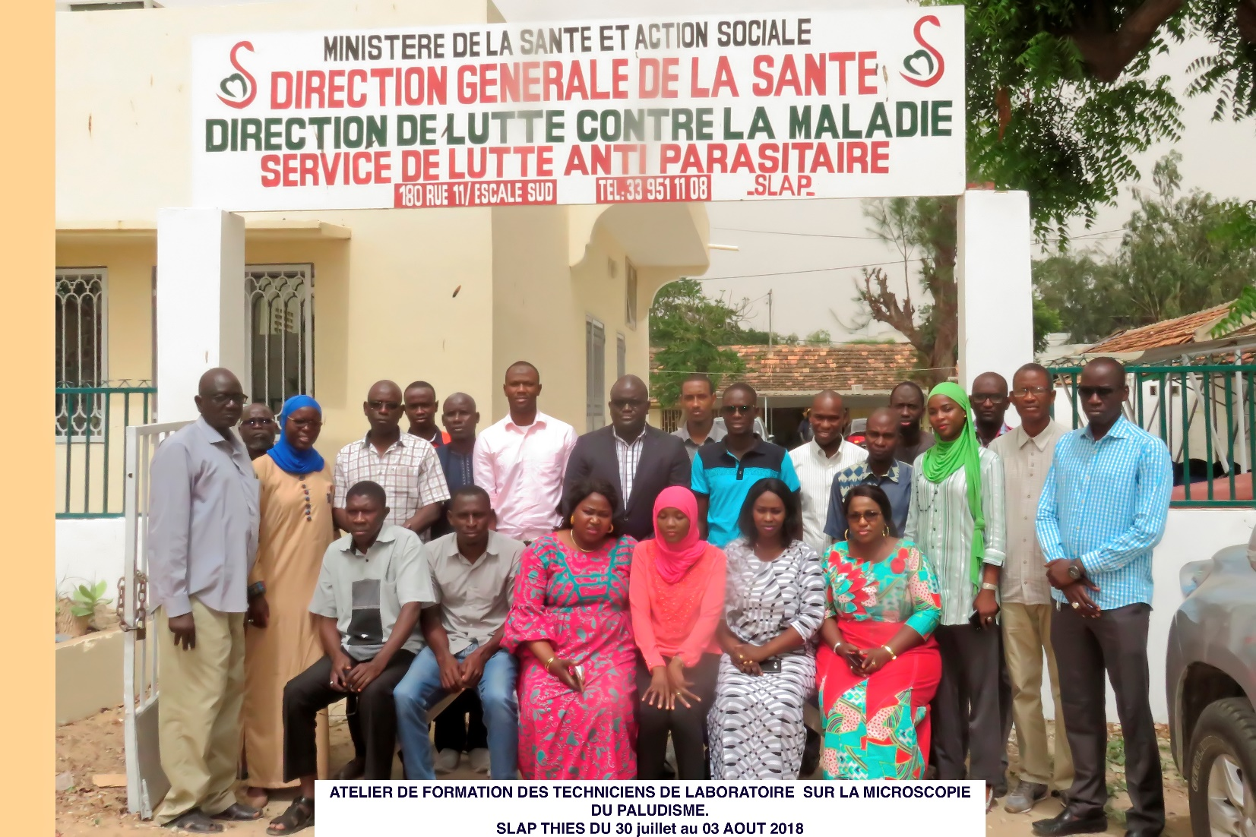
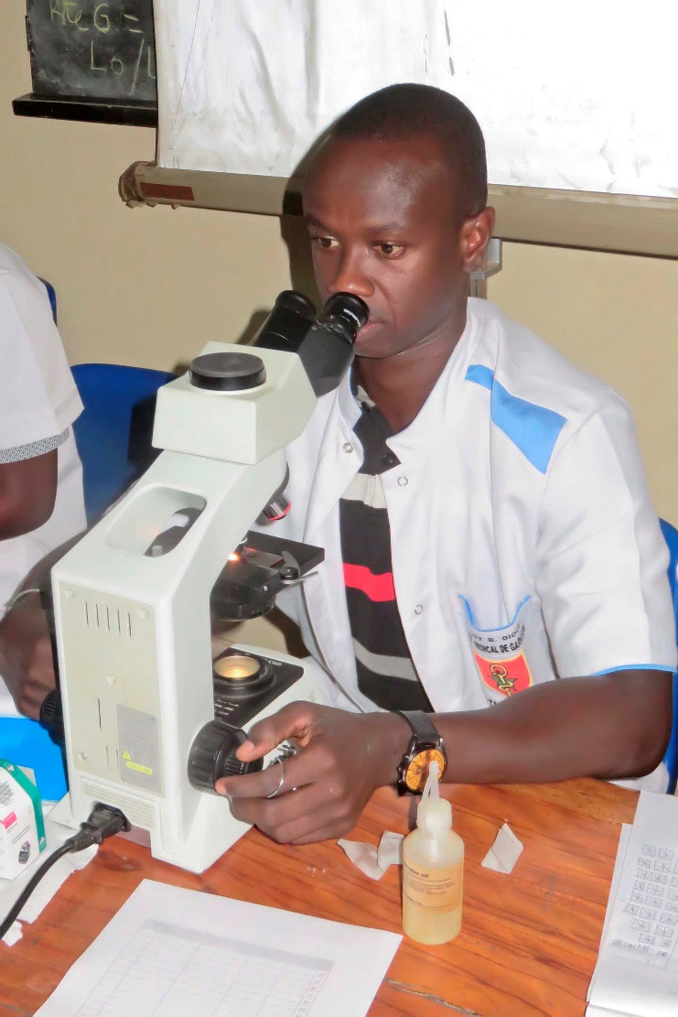
Training
Malaria microscopic diagnosis
Session 2
Sergent Barro

Slide 10
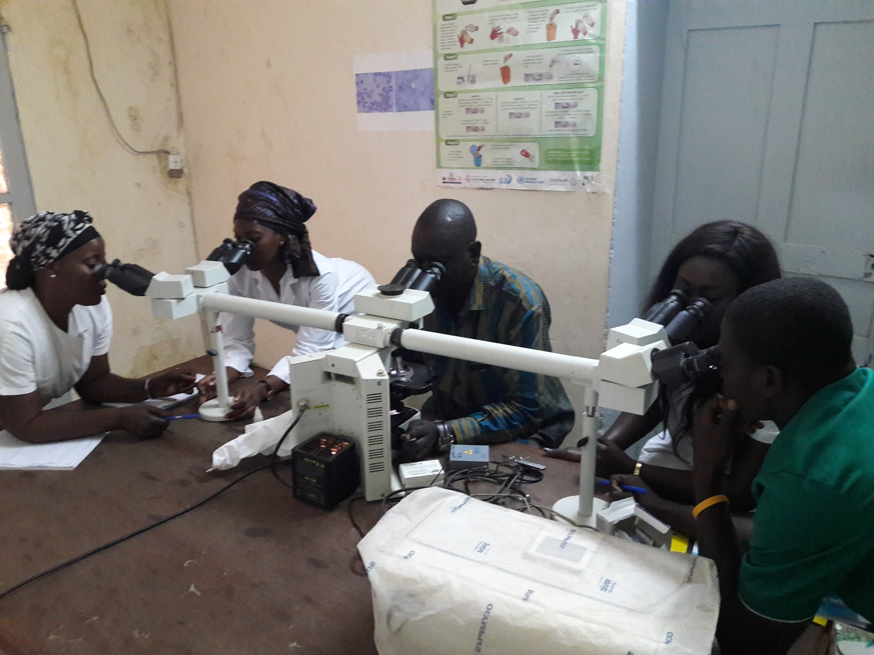
Training
NMCP training facilitation
We participate as a facilitator in training sessions in malaria microscopic diagnosis since 2016
Workshop: Malaria microscopic diagnosis, Thies-2018

Slide 11
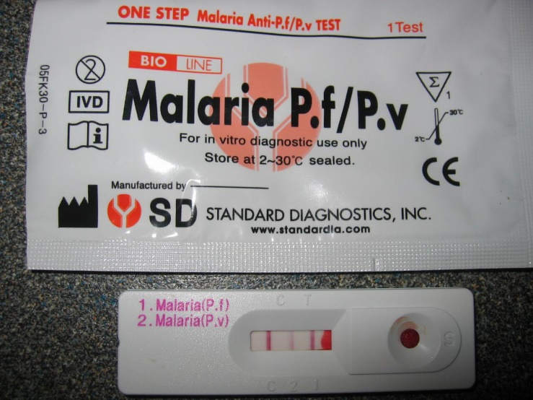
Malaria case management supplies
Malaria biological diagnosis supplies
  Rapid diagnostic test (RDT),
  Consumables for thick drop / blood smear

Slide 12
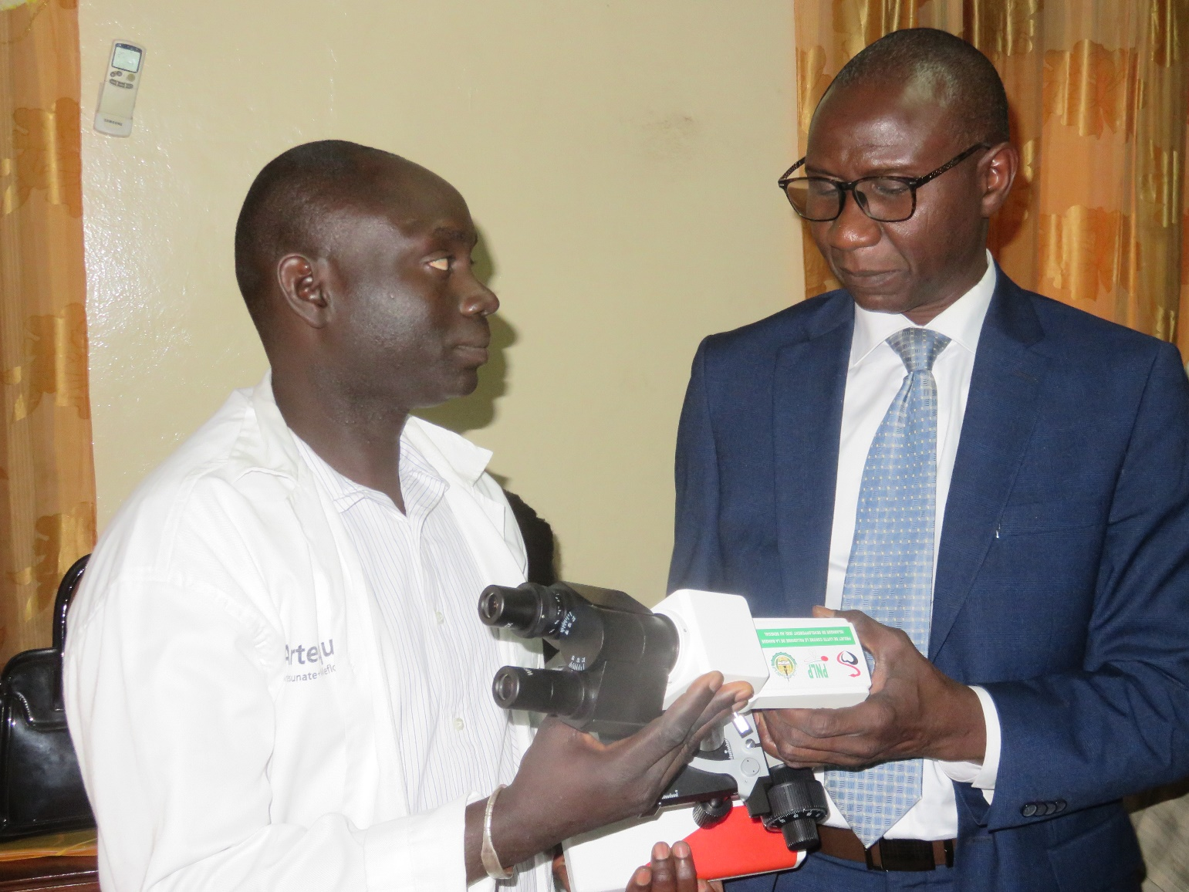
Malaria case management supplies
Lab military technician receiving a microscope during a training session (July 2018)

Slide 13
Malaria case management supplies
Drugs for the clinical management of malaria in military health facilities (Hospital, GMC and MHP) received from the medical district
  ACT (artemisinin-based combination therapy)

Slide 14
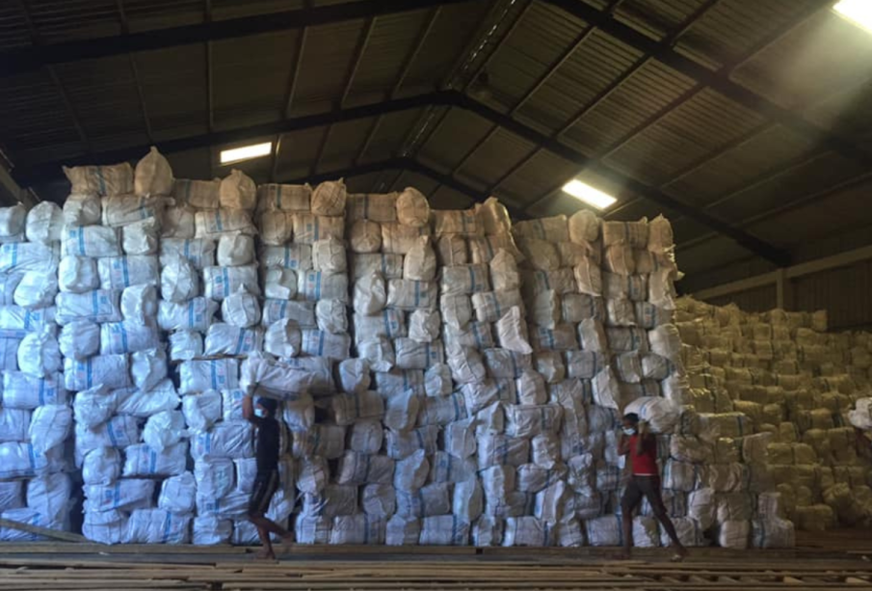
Country-wide net coverage campaign
Army warehouses to store mosquito nets for the NMPC

Slide 15
Monitoring and evaluation
Medical military staff take part in monitoring & evaluation missions organized by the NMCP in the health facilities (civilian and military)

Slide 16
Senegal as an example in Africa
Created in 2011 with 5 countries by USAFRICOM
In 2019 : 21 countries
Goal: Fight against malaria in African armies

Slide 17
Senegal as an example in Africa

Slide 18
Acknowledgements
General Staff of the Armed Forces
Army Forces Health Service Staff
National Malaria Control Program

Slide 19
Thank you !
19

