Slide 1
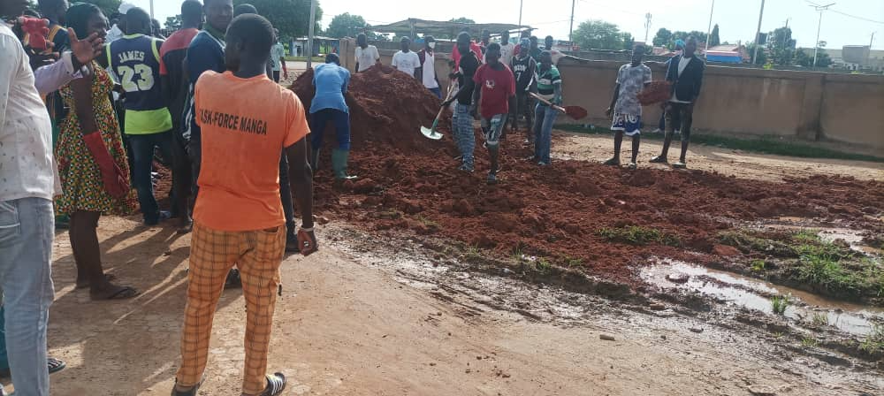

TRAINING WORKSHOP
ON MULTISECTORAL APPROACHES AGAINST MALARIA
Introduction and Objectives
Florence Fouque - IMP/TDR/WHO
Joint activity in Manga, Burkina Faso, to eliminate the malaria vectors breeding sites
UNPDF project, Saly, Senegal, 11 to 14 September 2023

Slide 2
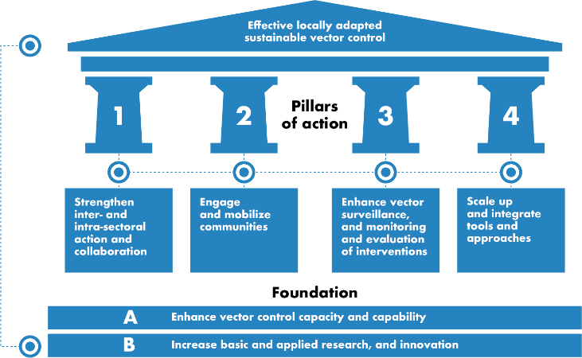

Multisectoral Approach is the First Pillar of the GVCR
REDUCE THE BURDEN AND THREAT OF VECTOR-BORNE DISEASES THAT AFFECT HUMANS
ENABLING FACTORS
Country leadership
Advocacy, resource
mobilization and partner coordination
Regulatory, policy
and normative support

Slide 3
RBM/UNDP Framework for Multisectoral approach against Malaria

Slide 4
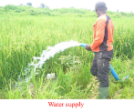
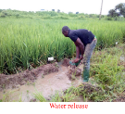
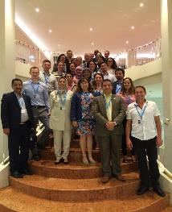
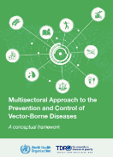

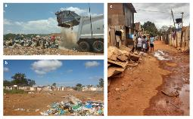
Multisectoral approach work in TDR
Multisectoral proposal in Mali-Benin-Burkina Faso and Nigeria
Figure 1: Rice plots showing water supply and release.
Multisectoral proposal in Ecuador
Multisectoral proposal in Brazil
Training

Slide 5
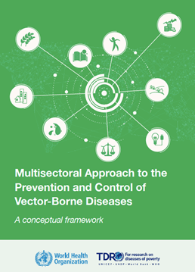
TDR Guidance Document
Evolution of malaria situation worldwide with stagnation of progress since 2015.
Context for COVID-19 pandemic and disruption of services.
In 2020 and 2021, increases in number of cases and numbers of fatalities (World Malaria Report, 2021, 2022).
Dual situation with countries achieving eradication and countries losing the progress from previous years.
How the other sectors can help on malaria control and receive benefits from malaria control.

Slide 6

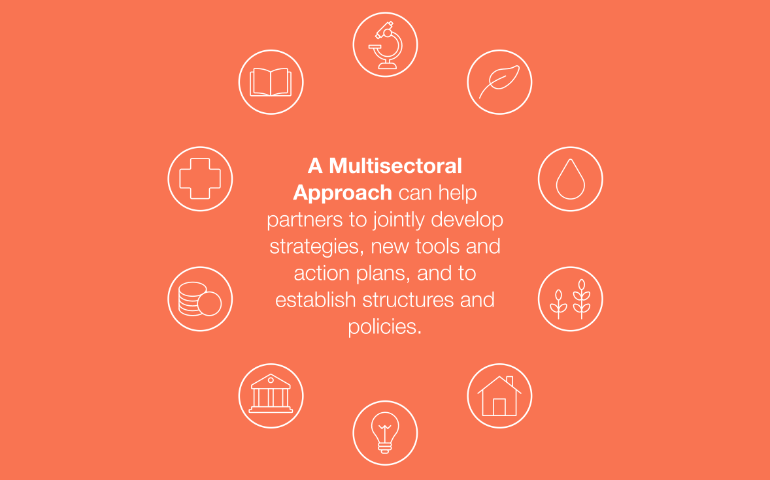
What is a Multisectoral approach ?
Agriculture
Water and Sanitation
Education
Health
Finance
Energy
Legislation
Housing

Slide 7
Objectives of the training workshop
To provide and explain the basic theoretical principles and components of a multisectoral approach.
To illustrate the concepts through sharing experiences and case studies of joint activities implemented by different sectors and aiming at the prevention and control of malaria in specific countries.
To focus on specific sectors for which the joint collaboration is already well engaged within WHO, such as the Water and sanitation sector.
To help the participants in designing draft MSA activities fitting to their own context and pick up a specific MSA activity for implementation in their own country.

Slide 8

MOOC on MSA – Module 1 - Introduction

Slide 9

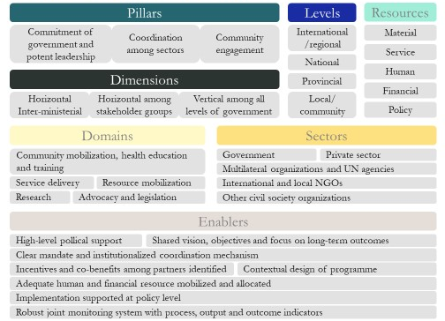
Module 2 - Components of Multi-Sectoral Approach
Zhong et al., 2020, J Infect Dis.

Slide 10
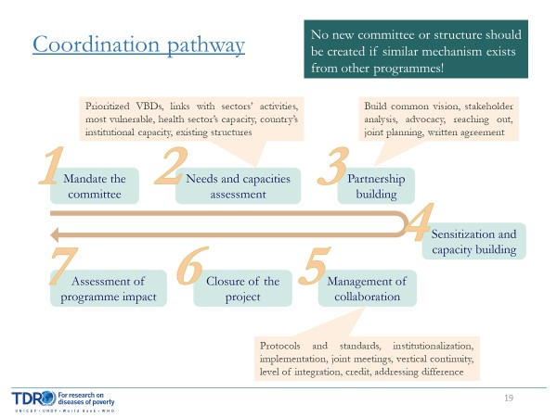
Module 3 - Coordination Pathways and Incentives
Example of incentives and collaborative actions with the Housing sector

Slide 11
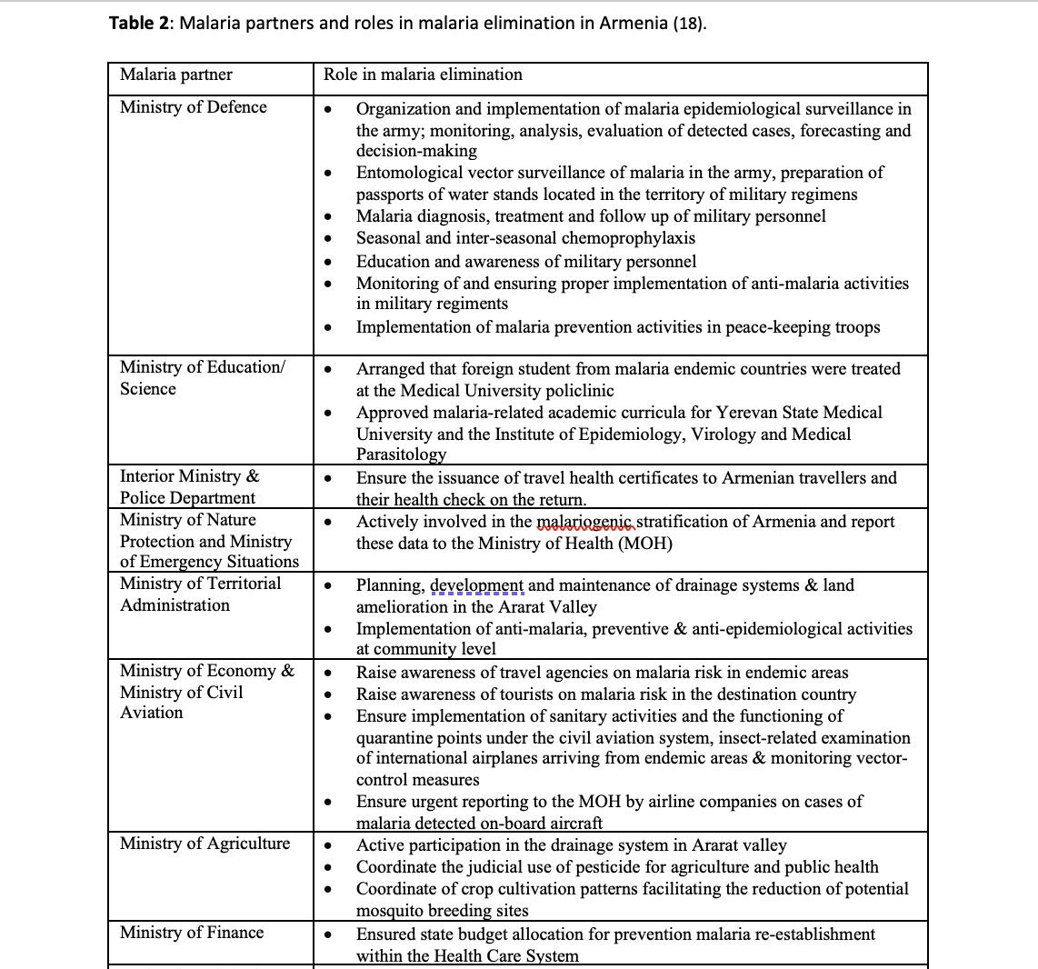
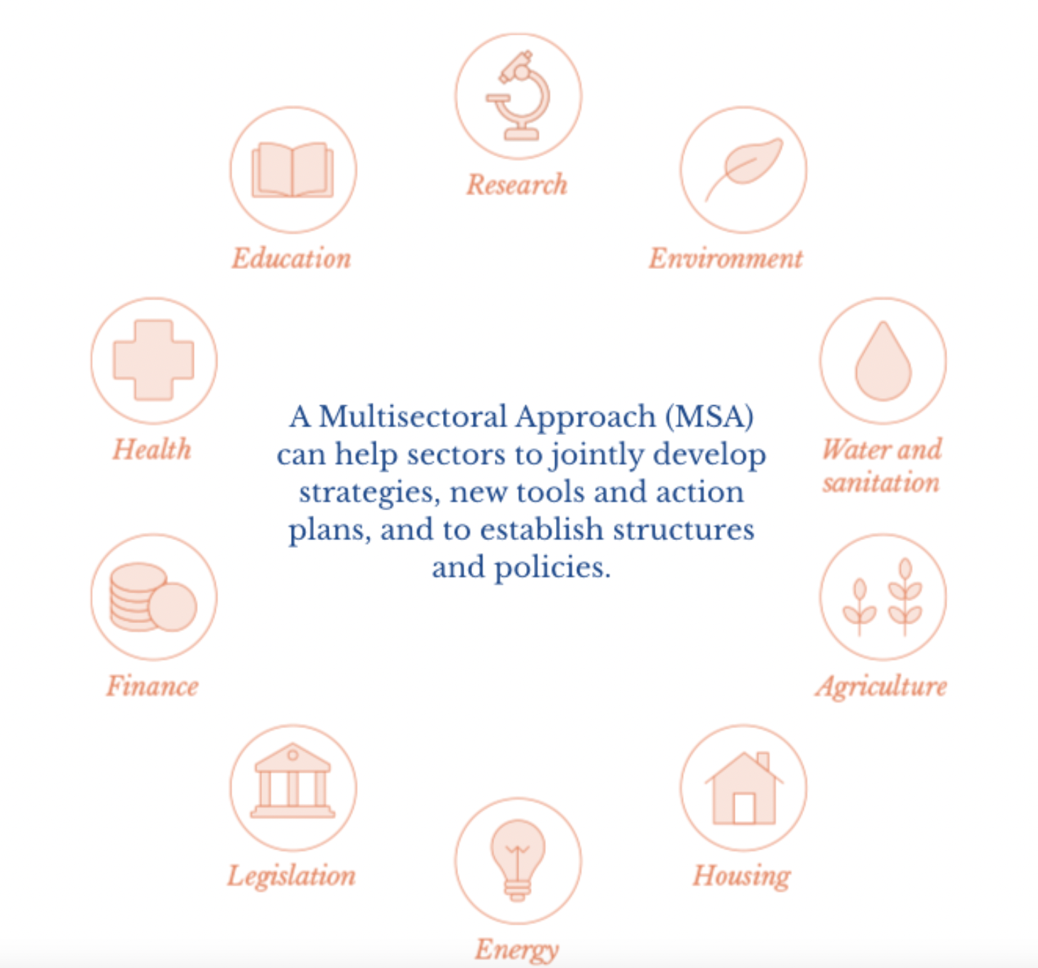
Module 4 - Sectoral Guidance

Slide 12
Expected Outcomes
Better knowledge of the processes and components of a multisectoral approach.
Capacity to develop and implement joint activities with different sectors and aiming at the prevention and control of malaria.
Understanding on how to work with specific sectors such as Water and Sanitation, Environment and Agriculture.
Plan and projects for MSA activities fitting to different context in different countries.

