Slide 1
Multi-sectoral approach against malaria
in the People’s Republic of China
Xiao-Nong Zhou
National Institute of Parasitic Diseases, China CDC
(Chinese Center for Tropical Diseases Research)

Slide 2
Malaria epidemics and control
Malaria elimination strategies and achievements与措施
CONTENTS
Prevention of re-establishment of malaria transmission

Slide 3
1
Malaria epidemics and control

Slide 4
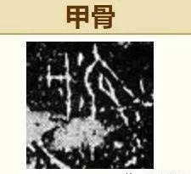
Malaria has a long history in China
The word malaria was found on the oracle bone of the Shang Yin era during 1562 to 1066 BC, indicating malaria had prevailed more than 3,000 years in China.
Malaria was a widespread disease in China, with an estimated 90% of the population at risk of infection in the 1940s
About 30 million cases and 300,000 deaths reported annually in the 1940s
Oracle Bone
Notes:
4

Slide 5
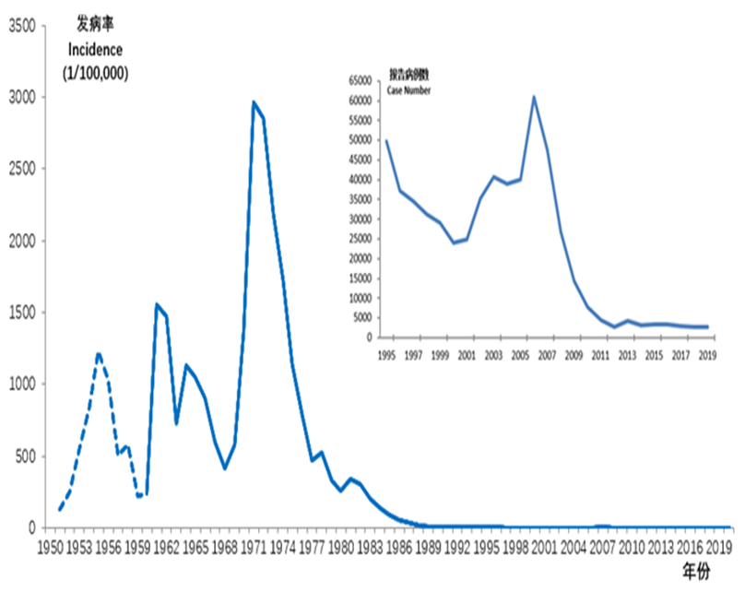
Malaria epidemic in China
Malaria epidemic was serious in 1950，accounting for >70% of total number of counties in China；Two country-wide epidemic peak occurred in 1960 and 1970；
The total number of epidemic counties was 2858 in the country
The last case infected with P. falciparum in 2015；The last case infected with P. vivax in 2016.
Zero indigenous malaria case recorded since 2017
Malaria epidemic status since 1950
5

Slide 6
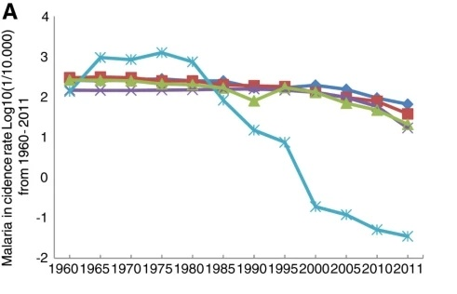
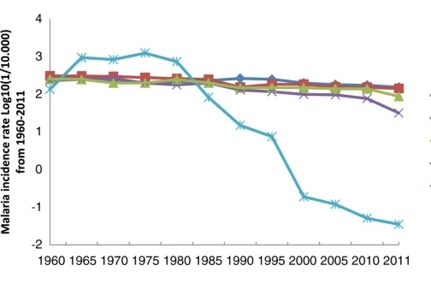
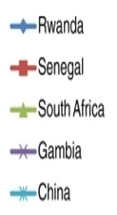
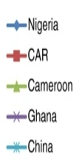
Trend in malaria incidence rate Log ₁₀ (1/10.000) in selected African countries and P.R. China from 1960–2011
Tembo et al. Infectious Diseases of Poverty 2012 1:7

Slide 7
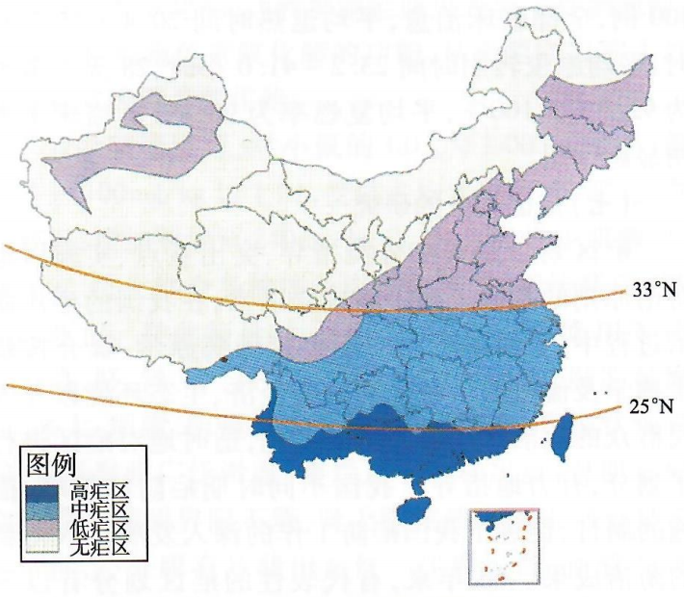
Stratification and Plasmodium spp.
Malaria epidemics and control
Region | Plasmodium Species | Epidemic Situation
South of 25°N | 4 species distribution | High or moderate
25~33°N | P. v : predominant, P. f also distributed | moderate or low, unstable
North of 33°N | mono P.v | low
North West | mono P.v | low: relatively scattered and isolated
33°N as the northern and southern dividing line of malaria-endemic areas

Slide 8
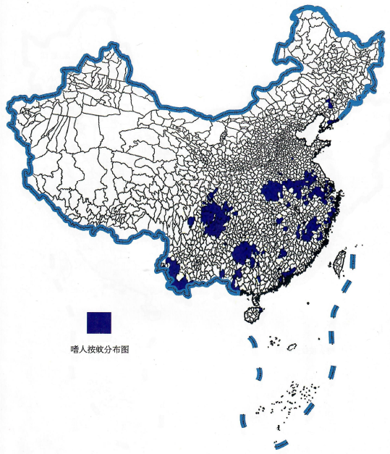
Malaria vector characteristics and distribution
Malaria epidemics and control
Anopheles spp. | Habits | Types of malaria transmitted
An. sinensis | Semi home-dwelling; human & livestock blood-feeding, prefer later | High susceptibility to P. v
An. anthropophagus | Human blood-feeding and home-dwelling; mainly inhabits in human houses but in livestock houses also | Susceptive to both P. v and P. f
An. minimus | Home-dwelling; densities in houses and barns varying by location during daytime | susceptive to both P. v and P. f
An. dirus | Preferentially feeding on human blood Habitat in the wild | susceptive to P. v, P. f and P. m

Slide 9
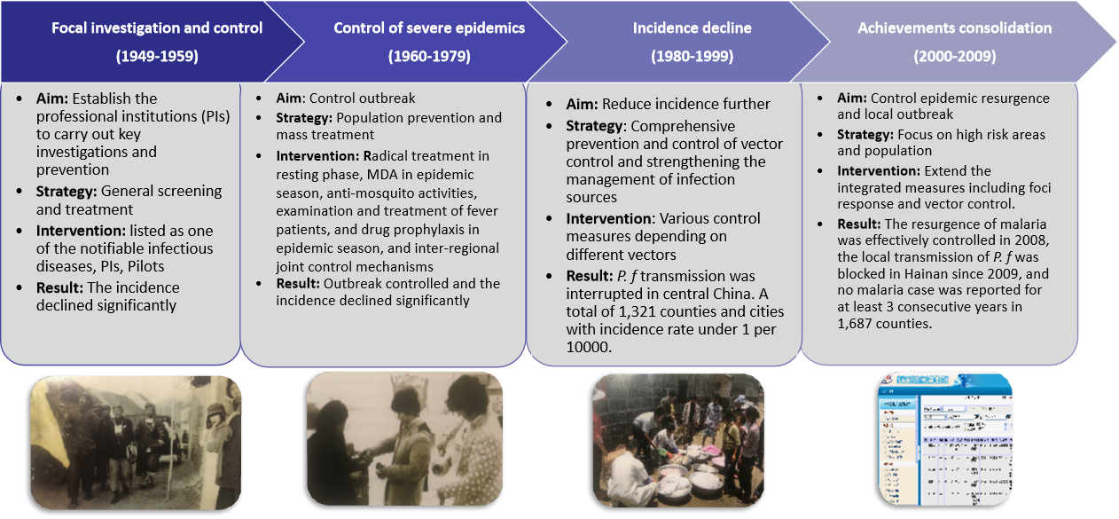
Malaria control phases
Malaria epidemics and control measures

Slide 10
2
Malaria elimination strategies and achievements

Slide 11
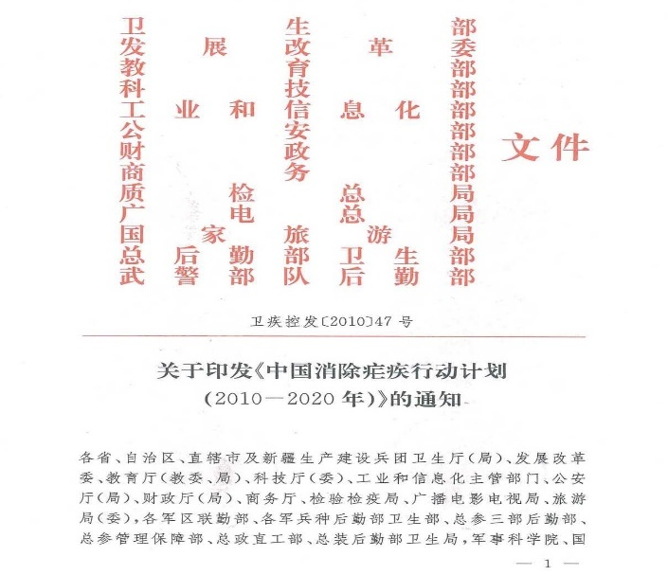
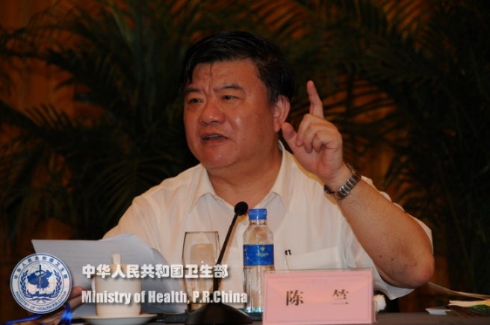
Action Plan for China Malaria Elimination（2010-2020）
In 2010, as part of the United Nations’ 2000 Millennium Development Goals, China ’ s National Health Commission recruited cooperation from 13 ministries to support the ambitious Action Plan for China Malaria Elimination (2010–2020),
which aimed to halt and reverse the incidence of disease by 2015 and eliminate local transmission by 2020.
总目标：
到2015年除云南边境地区外，其他地区均无疟疾当地病例传播；
到2020年全国范围内实现消除疟疾目标，即连续三年无当地感染病例传播。

Slide 12
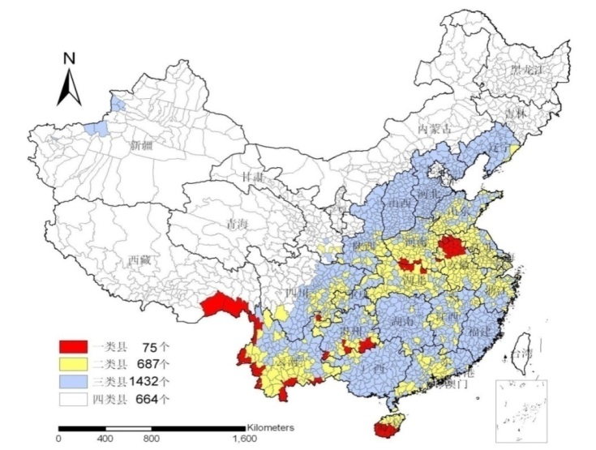
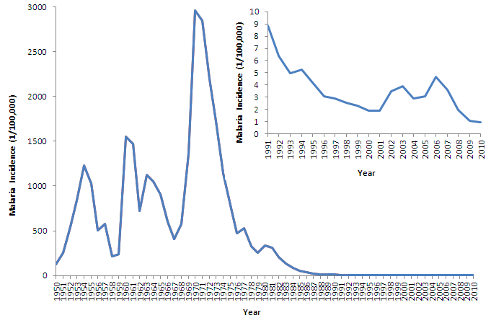
Great progress for achieving malaria elimination
The country has effectively controlled malaria within its borders, with no indigenous cases reported since 2017, — the first time for such report in the country ’ s history.
The country was certificated the malaria-free by the World Health Organization.

Slide 13
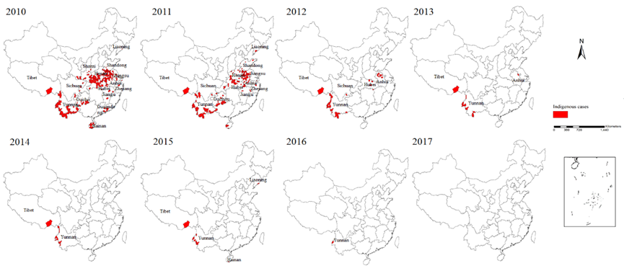
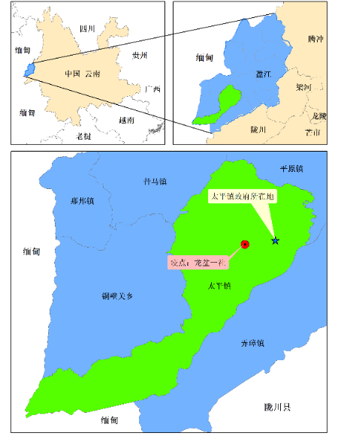
Malaria elimination strategy, measures & achievements
Goals and achievements in malaria elimination
Goals | By 2015, there will be no indigenous case of malaria infection in other areas of the country except some border areas in Yunnan
 | By 2020, natioanl malaria elimination
The last indigenous case of P. v reported in Yunnan, 2016

Slide 14
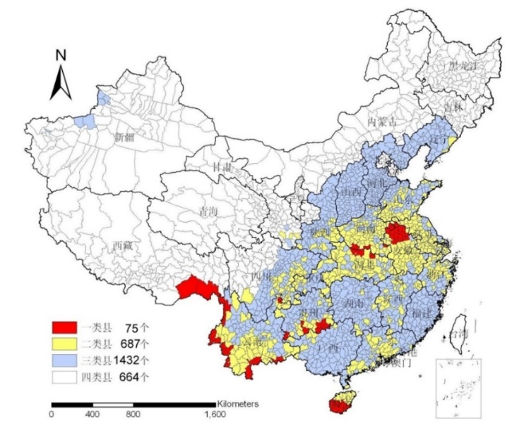
Stratification and strategies
Malaria elimination strategy, measures & achievements
Category I counties | Intensifying the strategy of “Population prevention and mass treatment”, and controlling both the source of infection and vector, to reduce the morbidity of malaria
Category Ⅱ counties | Strengthening case finding and foci clear, to block the transmission of malaria in the local
Category Ⅲ counties | Strengthening surveillance and response to the imported malaria cases, to prevent the secondary transmission.
Category Ⅳ counties | Strengthening the capacity of malaria diagnosis and treatment, reduce both the morbidity and mortality of severe malaria
Case tracking
discovering and determining the source of infection based on the reported indicator case of malaria
Foci response & infection elimination
counter-measures in clear up the source of infection in order to effectively interrupting transmission in confirmed foci

Slide 15
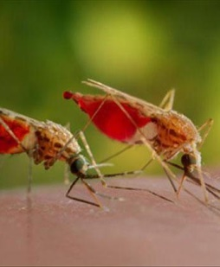
Key interventions in malaria elimination
Malaria elimination strategy, measures & achievements
Surveillance & response
Case diagnosis & QC
Case management
Cooperation & health education
Vector surveillance & control

Slide 16
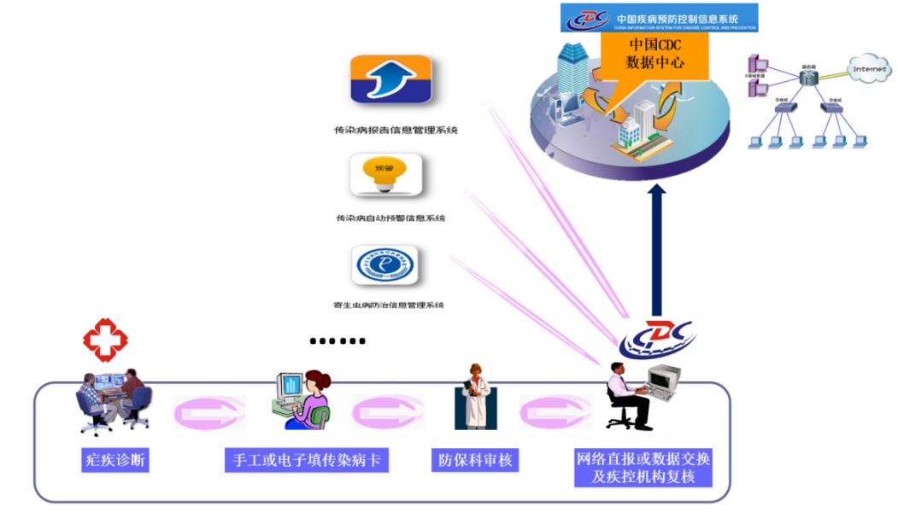
Information system
Malaria elimination strategy, measures & achievements
Chinese Information System for Disease Control and Prevention(CISDCP) (2004)
Information management system for parasitic disease control (2011): malaria subsystem

Slide 17
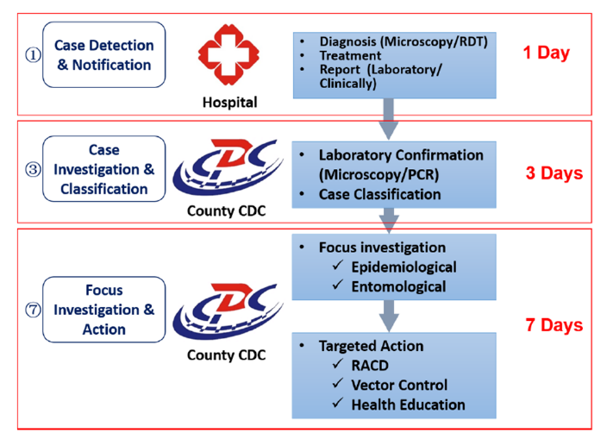
“1-3-7” approach
Malaria elimination strategy, measures & achievements
Year | Case number | rate of case reporting in 24h (%) | rate of case investigation in 3 days (%) | foci ivestigation and response in 7 days (%)
2013 | 4137 | 100 | 96.9 | 87.9
2014 | 3081 | 100 | 88.4 | 95.0
2015 | 3277 | 100 | 99.8 | 95.9
2016 | 3320 | 100 | 98.5 | 89.9
2017 | 2861 | 100 | 83.7 | 93.4
2018 | 2678 | 100 | 93.0 | 95.8
2019 | 2674 | 100 | 97.9 | 97.1
2020 | 1086 | 100 | 97.8 | 97.4
Time (day) | Content
1 | all malaria cases must be reported to the CISDCP within one day (24 hours)
3 | the completion of case confirmation and epidemiology investigation within 3 days
7 | the foci investigation and reponse completed within 7 days

Slide 18
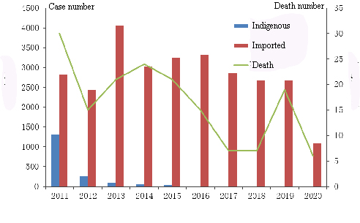
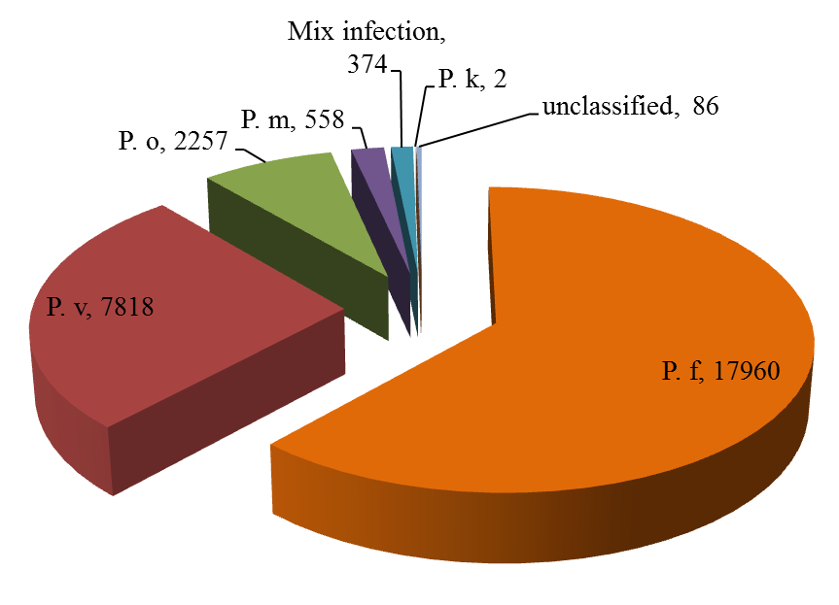
Malaria elimination strategy, measures & achievements
Summary of cases (2011-2020)
A total of 30278 cases were reported.
1732 indigenous cases, 28173 imported cases, 9 induced cases, 5 long incubation cases and 4 introduced cases
Clinical cases of 1223 .
Confirmed cases of 29055 including 17960 Pf cases, 7818 Pv cases, 2257 P. o cases, 558 Pm cases, 374 mix infected cases, 2 Pk cases and 86 unclassified cases.

Slide 19
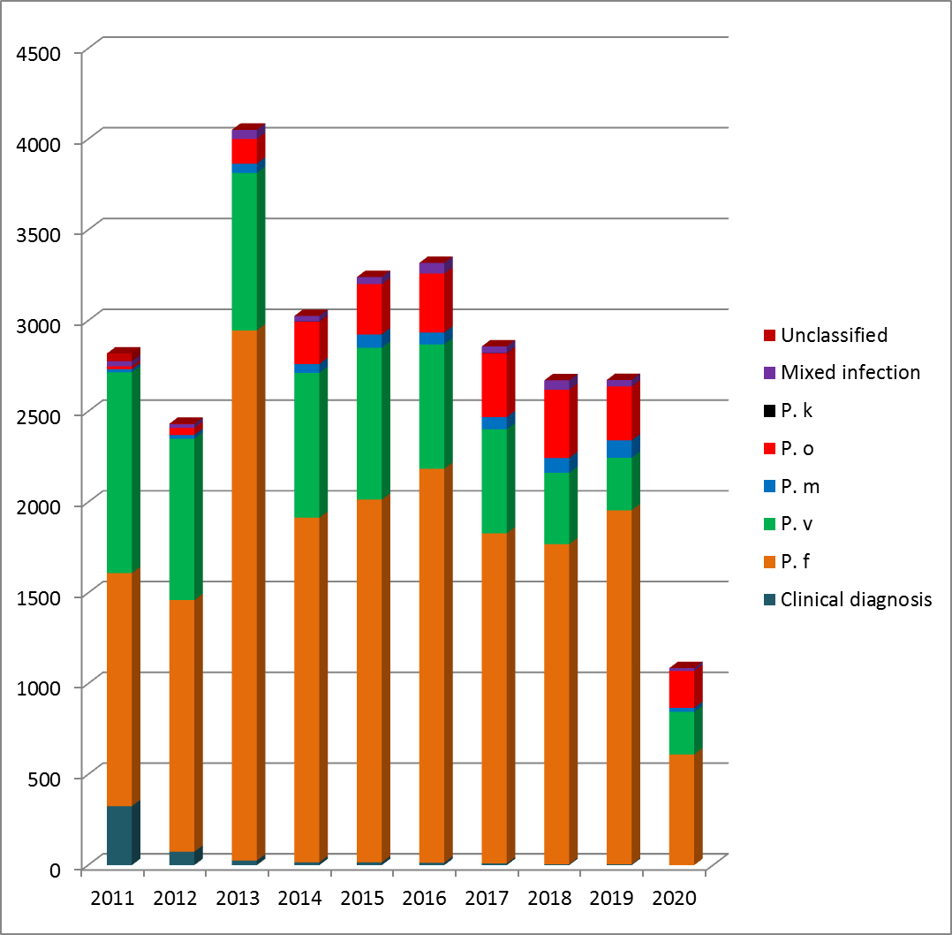
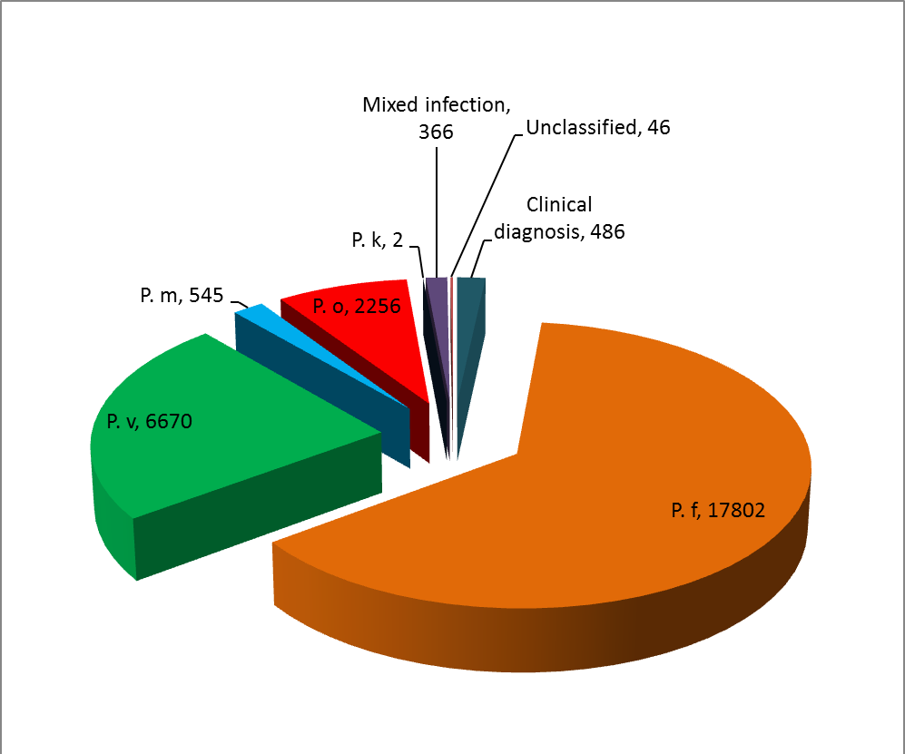
Imported cases (2011-2020)
Malaria elimination strategy, measures & achievements

Slide 20
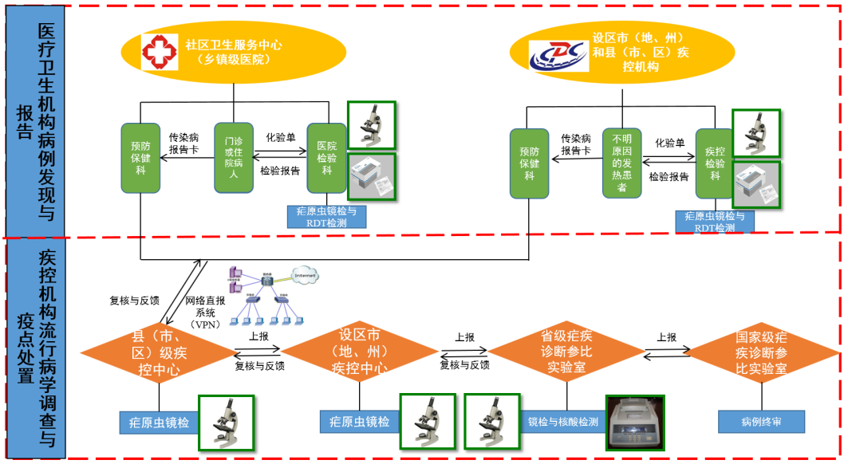
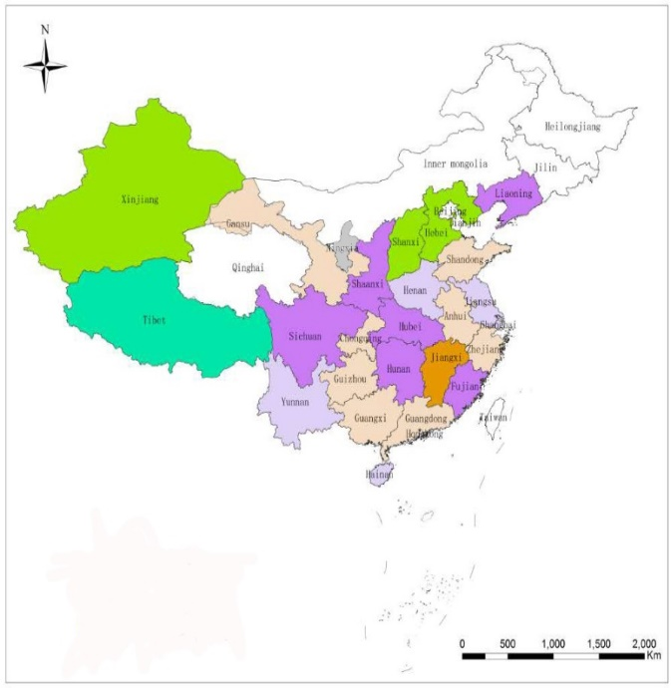
Malaria elimination strategy, measures & achievements
1. Malaria diagnostic laboratory network
Malaria Diagnostic Reference Laboratory Network
Laboratory network operational mechanism

Slide 21
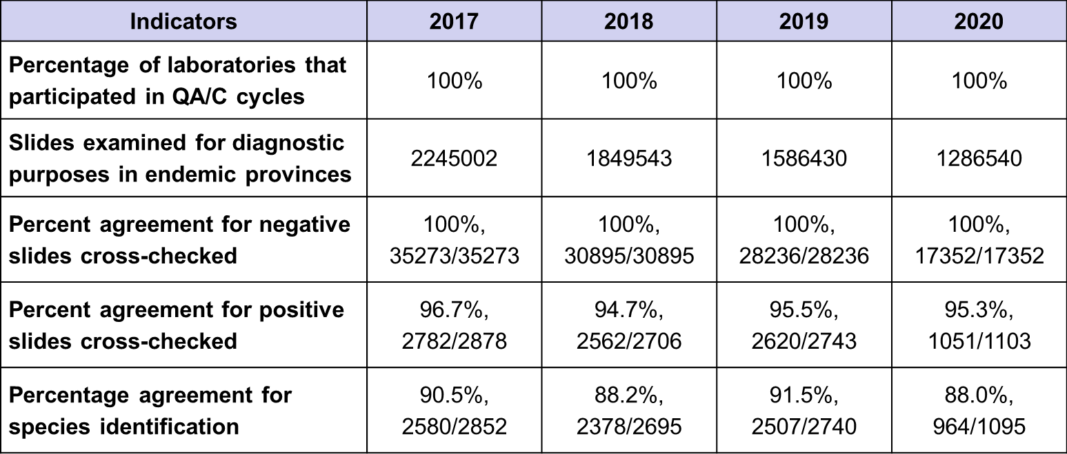
Malaria elimination strategy, measures & achievements
2. Blood smear cross-checking (2017-2020)
cross-checking of positive slides: microscopy and PCR cross-checking of each case based on provincial reference laboratories
species consistency rate: determination of non - P. falciparum (Differentiation between P. ovale and P. vivax)

Slide 22
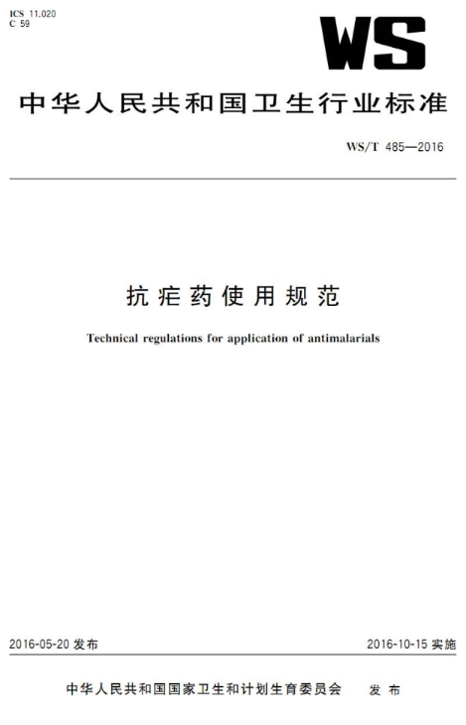
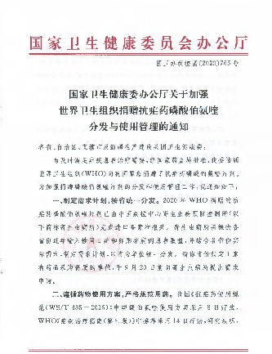
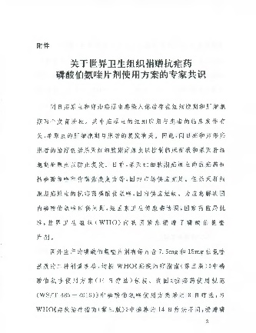
3. Case treatment
Malaria elimination strategy, measures & achievements
Vivax
Ovale
Preferred: Chloroquine plus primaquine (8-day therapy)
Second choice: ACTs plus primaquine (8-day therapy)
G6PD test: Before the use of Primaquine in some minority areas
Radical cure: Primaquine (8-day therapy) before next transmission season
Malariae
Chloroquine (3-day therapy)
ACTs
Falciparum
ACTs
Severe
Artesunate injection
Artemether injection or Pyronaridine

Slide 23
4. Drug efficacy surveillance
Malaria elimination strategy, measures & achievements
Drug sensitivity surveillance:
Sentinel sites: Yunnan border areas and the provinces with more imported cases；
Provincial CDCs: in vivo and in vitro assays following WHO guideline, drug resistance genes detection
P. falciparum to artemisinin
P. vivax to chloroquine
Result:
P. vivax to chloroquine: sensitive
P. falciparum to artemisinin: sensitivity is decreasing in the border areas of Yunnan, but no clear resistance to artemisinin
Drug resistance surveillance network (2016)
Yunnan border + Provinces with more imported cases

Slide 24
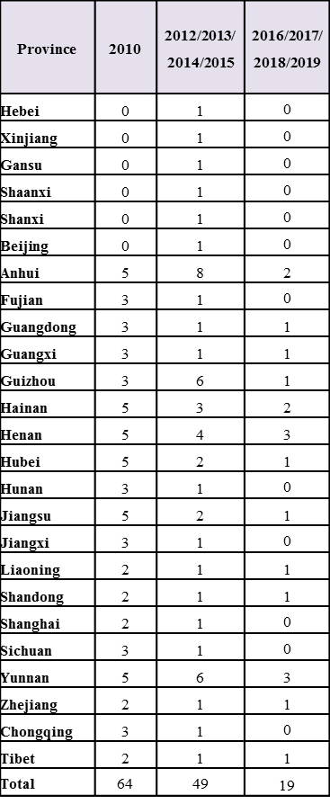
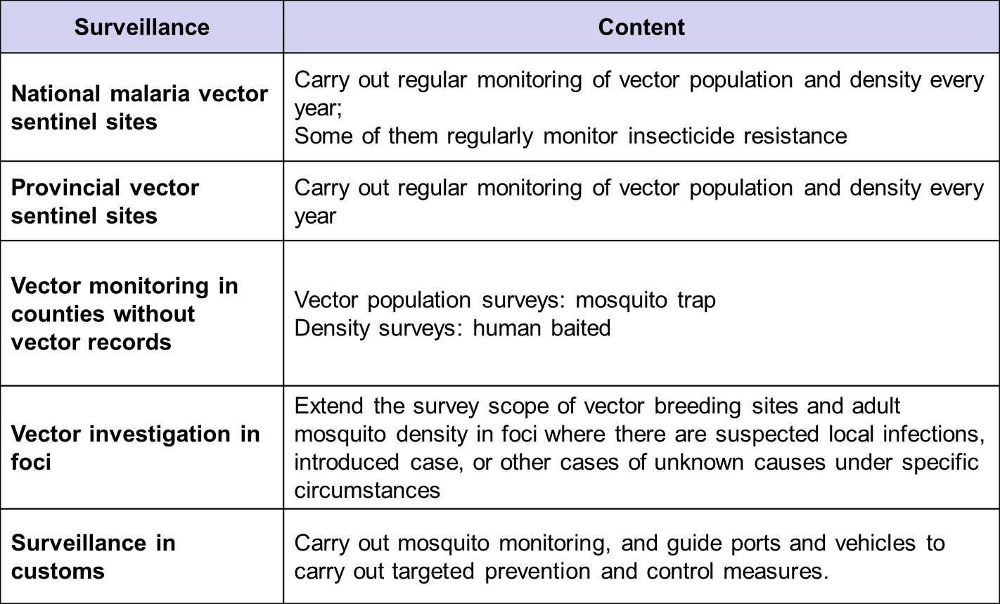
5. Entomological surveillance
Malaria elimination strategy, measures & achievements

Slide 25
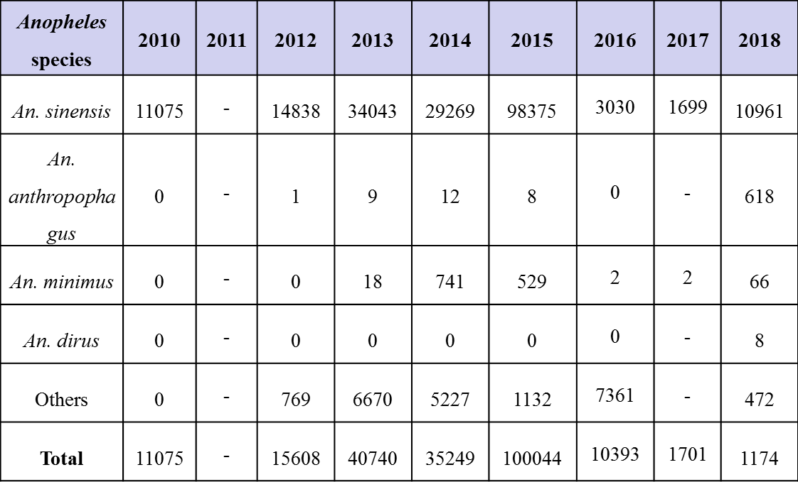
Malaria elimination strategy, measures & achievements
Anopheles population, species, and insecticide resistance
Insecticide resistance surveillance of An. sineniss
2014-2016
Hainan: sensitive to 5.0％ malathion and 0.05％ deltamethrin, but resistant to carbamates and organnochlorine
Sichuan, Yunnan, Shandong: resistance to all insecticides reached the WHO standard
2017
Henan, Hainan: sensitive to 5.0％ malathion, resistant to the other three insecticides
2018
Guangdong: suspected resistance to pyrethroid
Hainan, Henan, Guizhou, Jiangsu, Hubei, Liaoning, Shandong: resistance to pyrethroid
Anopheles in national vector sentinel sites

Slide 26
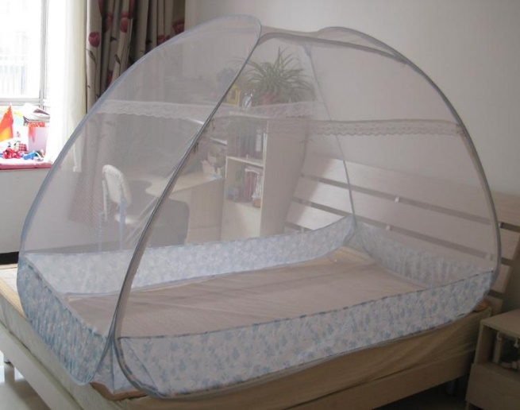
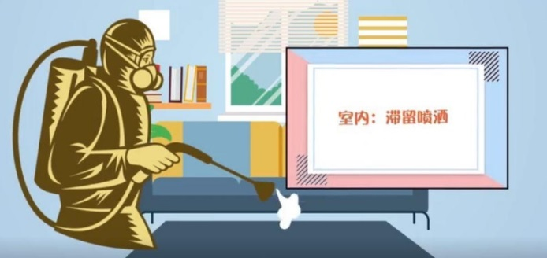
6. Vector control
Malaria elimination strategy, measures & achievements
Insecticide-treated nets：Since 2010, ITNs/LLINs have been used as an important supplementary strategy for vector control in Yunnan and Hainan provinces, to advance the malaria elimination progress.
Indoor residual spraying (IRS):
In the focus where transmission has occurred, IRS is mainly used to eliminate infectious Anopheles mosquitoes;
while in the foci with potential transmission, IRS is used in the key areas to eliminate the suspected infected adult Anopheles
Insecticides：mainly pyrethroid, such as beta beta-cyfluthrin suspension concentrate and beta cypermethrin suspension concentrate
Year | Number of ITN/LLIN | Number of residents protected by IRS
2011 | 1840792 | 1043963
2012 | 251555 | 1092158
2013 | 58874 | 447639
2014 | 19899 | 504936
2015 | 29611 | 1697188
2016 | 26562 | 272108
2017 | 11349 | 352732
2018 | 5987 | 161224
2019 | 1807 | 206599
Total | 2246436 | 5778547

Slide 27
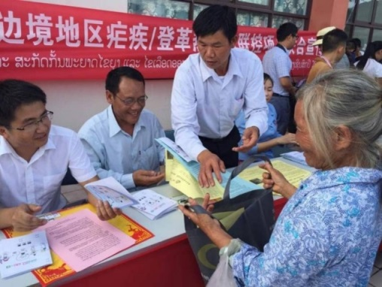
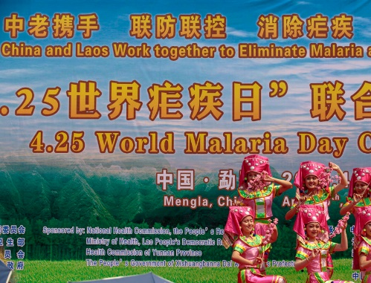
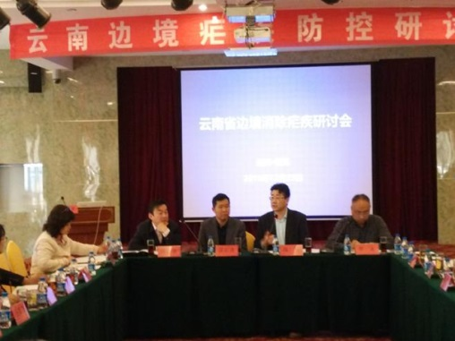
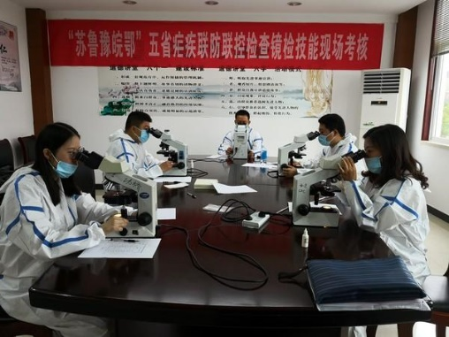
7. Cooperation & Health education
Malaria elimination strategy, measures & achievements

Slide 28
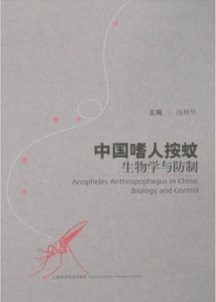
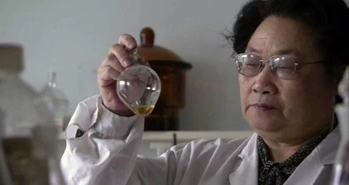
8. Operational research
Malaria elimination strategy, measures & achievements
Research and development, promotion and application of new antimalarial drugs
Research and application of malaria control and elimination strategies and measures
Research on Biology and Control of Anopheles

Slide 29
3
Prevention of re-establishment of malaria transmission

Slide 30
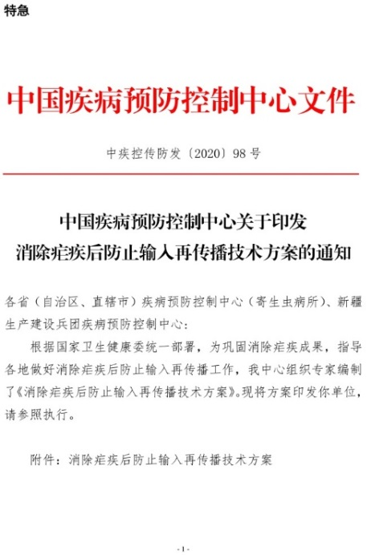
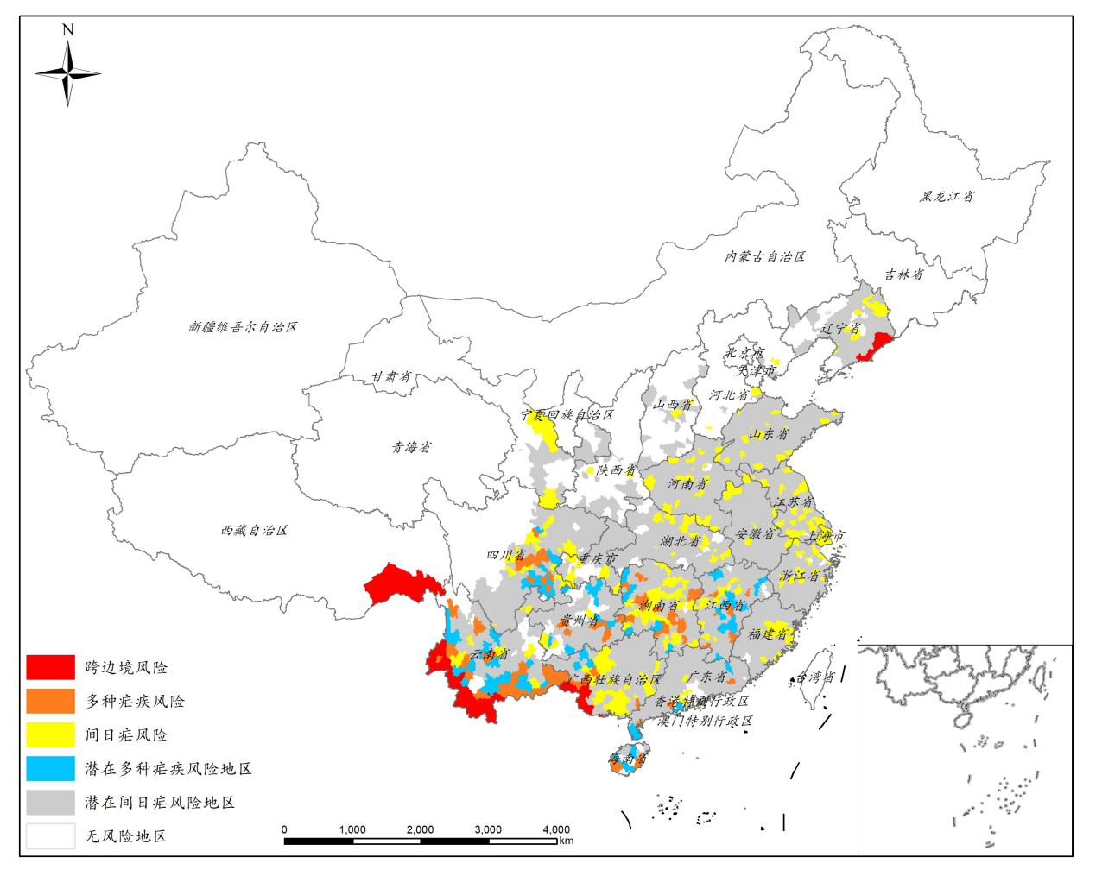
Risk stratification for the re-transmission
Prevention of re-establishment of malaria transmission
Promptly detection, precise interruption:
Intensified "1-3-7" appoach, timely detection and standardized treatment of imported cases, assessment of the risk of secondary transmission, timely disposal, and effective blocking

Slide 31
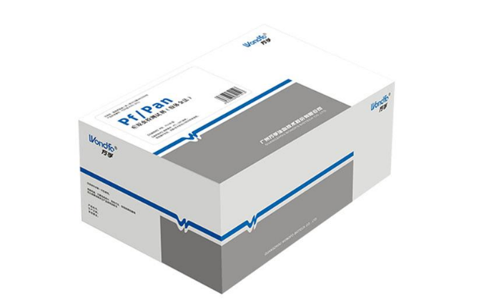
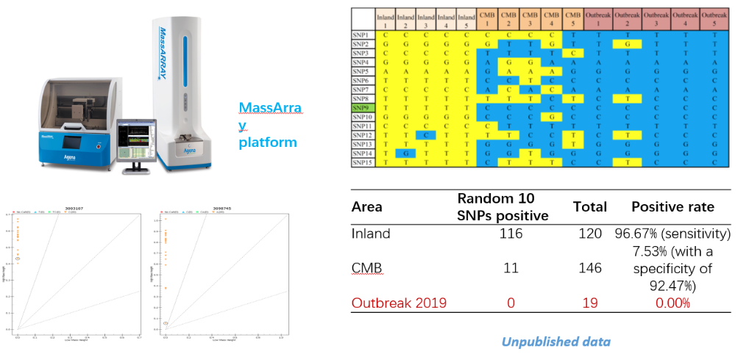
Case diagnosis and quality control
Prevention of re-establishment of malaria transmission
Microscopy or RDT in medical institutions
Malaria Diagnostic Reference Laboratory
QC network of laboratory testing and competency training
Capacity maintenance of case diagnosis and treatment
Severe Malaria Treatment Expert Group
Research on new testing and source tracking Technology

Slide 32
Vector control and surveillance
Prevention of re-establishment of malaria transmission
Vector control
Focus | Measures
Foci with potential transmission | IRS within a radius of less than 500 meters around the patient's home to kill potential positive adult anopheles mosquitoes
Foci with emergencies | IRS for all residential houses and livestock houses within foci to clear the positive adult anopheles mosquitoes, and extend to neighboring villages if necessary
Vector surveillance
cross-border areas and areas with risk of re-introduction will be the priority
sentinels have been adjusted and added
each county with risk of re-introduction and potential transmission risk need to update vector data every three years
ensure that about 1/3 of counties with t risk of re-introduction potential transmission risk have entomological surveillance data every 3 year
Capability sustaining in vector control and surveillance
Institution | Capability
National and provincial CDCs | Identification of anopheles
National and conditional provincial CDCs | Insecitcide resistance surveillance
CDCs at all levels | vector investigation and vector control

Slide 33
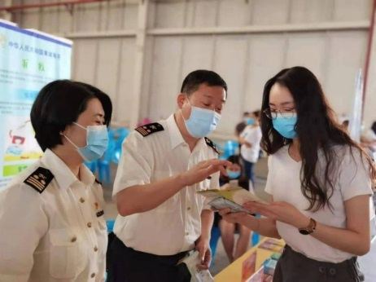
Traveller health, Health education, Cooperation
Prevention of re-establishment of malaria transmission
Travellers
Customs (ITHAN)
Immigration agency
Others
Travel agency for overseas travel
Health (CDCs)
Malaria KAP
Free consultation for fever visits
Anti-mosquito facilities and product use
Laboratory testing
......

Slide 34
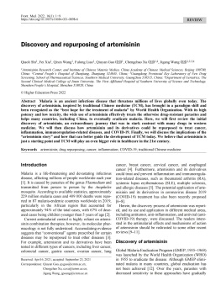
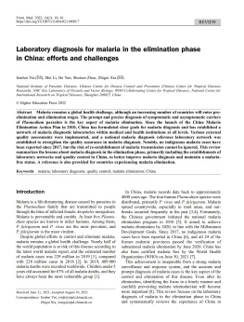
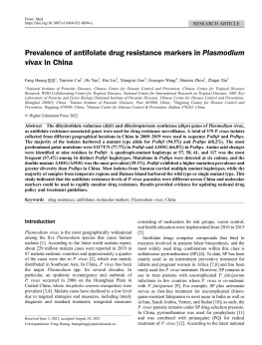
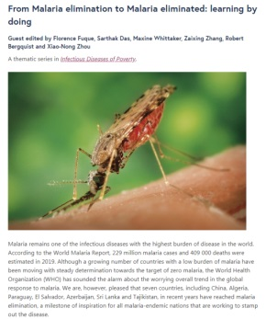
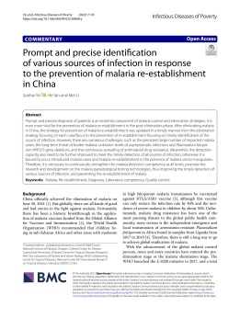
Publications
Frontiers of Medicine: 4 papers
Infectious Diseases of Poverty: 6 papers
Advances in Parasitology: 7 papers

Slide 35
Case 1. Response to the outbreak in Hainan Province
The ratio of different species of Plasmodium in1954-2009
Pf was eliminated by 2009 in Hainan Province, and Pv was eliminated by 2012. Pm was reported before 1964. Po was found in 1956. Suddenly, Pm was found in 2015.

Slide 36
Case 1. Response to the outbreak in Hainan province

Slide 37
三、疟疾病例发现
No. | Name | Genda | Age | Time of detection | Fever time | Time for mountain going | Estimated Infection place
病例1 | 陈*强 | 男 | 31 | 8/9 | June | May | Mountain
病例2 | 陈*龙 | 男 | 19 | 15/9 | May | April | Mountain
病例3 | 李*进 | 男 | 27 | 17/9 | April | April | Mountain
病例4 | 李*师 | 男 | 31 | 19/9 | May | May | Mountain
病例5 | 邓*明 | 男 | 40 | 17/10 | June | 5May | Mountain
病例6 | 李*昌 | 男 | 25 | 26/11 | May | - | Village

Slide 38
四、疟疾病例调查处置
Notes:
直报系统：传防染病信息报告系统
专报系统：寄生虫病防治信息系统
38

Slide 39
Case investigation

Slide 41
Response actives
Notes:
图片需要修改
41

Slide 42
Case 2. Response to the outbreak in Henan Province
Q&A
For vector control, there are many vector control measures, how to choose?

Slide 43
Malaria outbreak in Henan and Anhui Provinces in 2005-2006

Slide 44
Control measures
Strengthen blood test
Case management
Vector control
MDA

Slide 45
Environmental
governance
Chemical
control
Biological
control
How many kinds of vector control measures ?

Slide 46
How many kinds of vector-control measures ?
What is the advantage and disadvantage for each of measures?
Type | Advantage | Disadvantage
Environmental governance | Solve the problem at the root and reduce the breeding ground of mosquitoes | It takes a long time, has a large amount of work and is not easy to manage
Chemical control | Efficient, fast, low price | It pollutes the environment and is easy to produce drug resistance, which has an impact on human health
Biological control | Operations can be carried out quickly; Harmless to other insects, fish, birds, mammals and humans at the recommended doses; Safe for use in multiple habitats including drinking water and on irrigated crops; Effective where mosquitoes have developed resistance to synthetic chemical larvicides. | Larvae must be feeding when the bacterial larvicide is present for it to be effective ; In open, natural habitats, Bti breaks down quickly in the environment, so more frequent applications may be needed.

Slide 47
Preparation before implementation
36 outbreak points
Characteristics of the population in the target area.
Malaria epidemiology
Demography
A
B
All possible breeding places of An.sinensis in the target area, draw the map.
Baseline
mapping
C
D
Larval & adult mosquito surveillance
Investigation

Slide 48
Bacterial larvicides
Only WHOPES-approved larvicides should be used for LSM, as listed at（http://www.who.int/whopes/Mosquito_Larvicides_Sept_2012.pdf）.
Bacillus thuringiensis subsp. israelensis (Bti)
In all habitats, less effective in very polluted habitats (e.g. latrines);
Needs to be applied weekly;
Cheap.
Bacillus sphaericus (Bs)
In all habitats – including very polluted water;
Application can give an extended residual;
Expensive.

Slide 49
Implementation
Production province: Jiangsu Yangzhou Lvyuan Biochemical Co., Ltd
Dosage: 8 ml / m² (surface of the water)
Specification: SC, 100 ITU mg
Sprayer: Hsun 1035 BP type (grain diameter less than 50 μm）
Frequency: once every 15 days

Slide 50
Implementation
20 ^{th} Aug. – 31st Oct. 2006
31 administrative villages were selected to carry out biological mosquito control measures.

Slide 51
Implementation effect
Effect of Bacillus sphaericus on the density of An. sinensis larvae
Effect of Bacillus sphaericus on the density of An. sinensis adult
The larval density of An. sinensis decreased by 76.2% and 75.6% after the first and third spraying, and decreased by 100% after the fourth spraying.
The adult mosquito density of An. sinensis decreased by 63.6% and 50% after the first and third spraying, and decreased to 0 after the fourth spraying.

Slide 52
Evaluation
In 2007, there was no outbreak of malaria in Yongcheng county. Compared to 2006, malaria incidence of treatment villages in 2007 decreased by 51.02%, while the decrease in control villages was 40.0%, the morbidity in the treated villages was lower than in the un-treated villages, with statistically significant differences (p<0.000).
Region | 2006 |  | 2007 |  | Increase or decrease rate (%)
 | No. of cases | Incidence rate（％） | No. of cases | Incidence rate（％）
Treatment village | 663 | 0.98 | 323 | 0.48 | -51.02
Control village | 1467 | 0.90 | 885 | 0.54 | -40.0

Slide 54
Sharing experiences with other counties for malaria elimination
Today, China continues to innovate in its path to malaria elimination by seeking to incorporate genetic tools to inform its efforts and is currently applying technological advances in genetic epidemiology.
Six African countries, including Burkina Faso, Cameroon, Cote d'Ivoire, Sierra Leone, Tanzania, and Zambia, have signed agreements with China to establish Institutional-based Networks of Cooperation between Africa and China on Malaria (INCAM).
More cooperation on China-Africa’s malaria elimination will be further strengthened.

Slide 56
Phase 2: China-Tanzania Demonstration Project on Malaria Control Supported by BMGF
Phase 3: China-Africa Cooperation Project on Malaria Control Supported by China NHC
General Objective
Promote China’s cooperation with Zambia and Tanzania in malaria prevention and control, explore the strategic framework for the cooperation, and establish the cooperation mechanism to support the sustainable development of China-Africa cooperation in malaria prevention and control.
Specific Objectives
1. To enhance the malaria prevention and control capacities in the proposed areas where intend to cooperate;
2. To gain a clear picture of epidemic situation and malaria prevention and control needs in Zambia and Tanzania;
3. To develop the implementation plan of the China-Zambia/China-Tanzania Cooperation Project on Malaria Prevention and Control.

Slide 57
Phase 4: UN Peace Fund Project
The strengthening the capacity of surveillance and response in selected African countries to control Malaria in different settings by China-Africa networking control malaria in different settings China-Africa networking (SCSR project)

Slide 58
Systems thinking
– complicated issue in health
Global vision
– equity issue in health

Slide 59
Acknowledgements
To all professionals involved in the malaria control and elimination programme in the People’s Republic of China !
Thank you!

