Slide 1
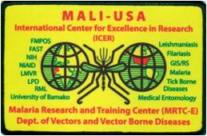

Multisectoral intervention for controlling malaria vectors and mitigating insecticide resistance in coastal and Sahelian West African countries.
Nafomon SOGOBA, MSc., PhD
ICER/MRTC-E/USTTB
Dakar 10-15 September 2023

Slide 2
Background
ITNS/LLINS, IRS, and larviciding have significantly contributed to reducing malaria incidences in several African settings
However, malaria persists and has resurged in some West African settings.
Contributors to this residual malaria include:
  Intense rice production and flooded rice fields maintaining mosquito breeding sites during prolonged dried seasons
  Pesticide misuse and overuse in agriculture which further spread insecticide resistance.
  Natural environmental conditions such as riverbeds identified as hotspots for larvae of malaria vectors during the dry season.
  Low presence of insecticide residues in LLINs which is likely to reduce the efficacy of treated nets and increase insecticide resistance selection in malaria vectors.
  Poor quality of WASH facilities which further contributes to increased transmission risk of water and vector-borne diseases.

Slide 3
Impacts
Improve malaria vector control in "hot spots", reduce malaria transmission and contribute to resistance mitigation
Theory of Change
Results
Reducing the misuse and overuse of agricultural pesticides by farmers
Reducing mosquito densities in hot spots and improving LLIN performance
Reduced malaria transmission and improve health systems
Outputs
Larval habitats and vector densities in riverbeds during the dry season are reduced
Agricultural pesticide residues in breeding sites are reduced
Better handwashing systems in CSCOMs and communities to improve quality of health
Insecticide residues in identified LLINs, for sensitization and decision-making improved effectiveness
MSA b/w Agric reinforcement models. Health and Approx. Ministries are identified and national staff are empowered
Agricultural Hotspot Reduction: introduce AWD/IIP and ASD into selected rice production sites, assess the number of mosquito breeding sites and larval densities following identified interventions. Reduction of environmental hotspots: Larvicide, destruction of breeding sites, analysis of pesticide residues in breeding sites, ASD, assessment of the number of breeding sites and larval densities after interventions.
Rational use of agro insecticides (IR mitigation): mapping susceptibility profiles of agricultural pests (insects) to pesticides, identifying the best pesticide for pest treatment in selected vegetable farms, analyzing pesticide residues in soil, water and plants, sharing data with agricultural extension workers for farmers' awareness
Analysis of pesticide residues in environmental hotspots: collection of water samples in anopheles larval lodges in riverbeds, detection of pesticide residues in lodges, analysis of susceptibility of anopheles to insecticides.
Quality control of LLINs to maintain their effectiveness in the context of IRs: quality control of insecticide residue concentrations in LLINs for community use, sharing data with NMCPs for awareness raising and decision-making.
Capacity building: empowerment of stakeholders (policymakers, technicians, Msc students)
W/Package
Assessment of the state of WaSH in CSCOMs: CAP study and direct observation to assess water management strategies, sanitary conditions of CSCOMs and the quality of workers' personal hygiene
Objectives
Reducing mosquito proliferation in riverbeds and rice fields during the dry season in the Sahel
Mitigating agrochemical selection pressure
Improving the effectiveness of LLINs
Strengthen the existing MSA Working Group and NMCP capabilities
Improving WaSH systems in CSCOMs
Project Investment
Poor water management and sanitation conditions in CSCOMs/communities leading to increased malaria transmission
Problems
High densities of Anopheles larvae in intensive rice production systems and riverbeds in the Sahel in the dry season
High insecticide resistance recorded in anopheles at agricultural sites
Low effectiveness of LLINs in controlling malaria vectors

Slide 4
Goal
Specific objectives include
Reducing malaria vector densities associated with river beds during the long dry seasons in the Sahel
Reducing the use of agro-pesticides to lower insecticide resistance in malaria vectors breeding near agricultural sites
Mapping out available WASH facilities and practices at healthcare units in selected villages
Reducing malaria vector density associated with landscape changes, such as intense rice production and flooded rice fields
Improving the effectiveness of LLINs by checking the quality of bio-efficacy and insecticide residues at sales points
Establishing a multisectoral advisory task force under existing integrated vector control (IVC) committees of the National Malaria Control Program in each of the participating countries
The broad objective of this project is to collaboratively work to mitigate residual malaria by:
Improving control of malaria
vectors in hotspots
Reducing the transmission
of residual malaria
Helping to mitigate insecticide resistance.

Slide 5
How do we organize the Implementation of the MSA Approach?
Creation of a meeting exchange platform
Identification of key stakeholders from the Ministry of Agriculture, Environment, and Health (technical extension and policymakers).
Sending of invitation letters for project start.
Technical and administrative discussions for smooth implementation of project activities
Launch of project activities

Slide 6
AIM#1: To reduce by more than 50% the densities of Anopheles breeding sites and mosquito densities in riverbeds during prolong dry season in Sahel region of Mali
Study site
The study was conducted in the fishing hamlets located along the Niger River where previous studies have shown that water pockets left in the riverbeds during the dry season, create anopheline larvae breeding

Slide 7
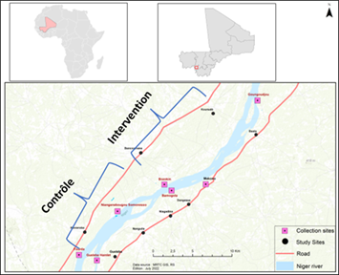
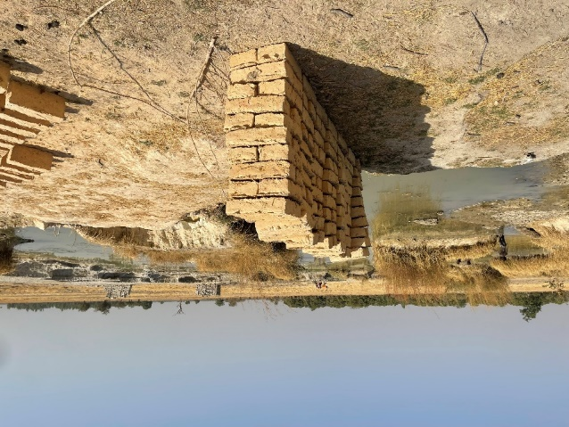
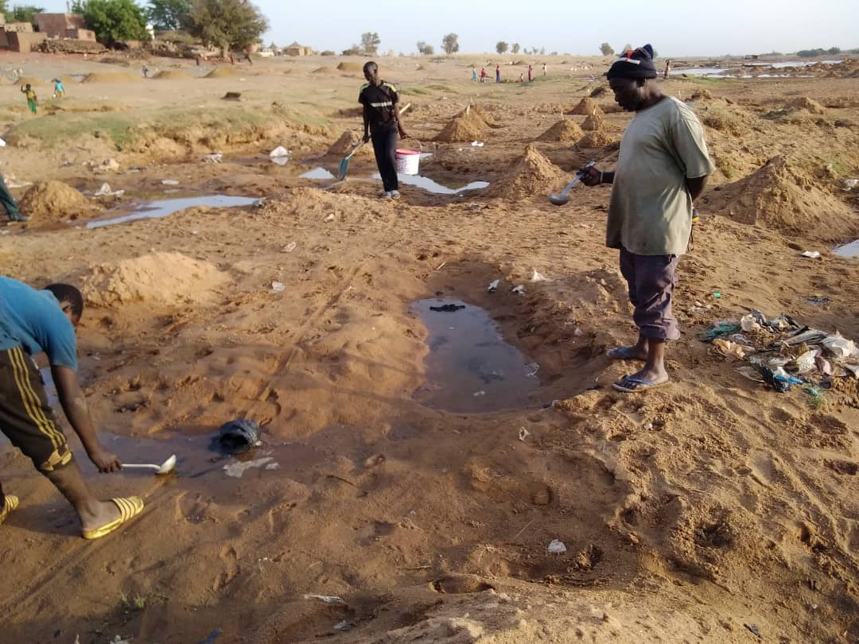
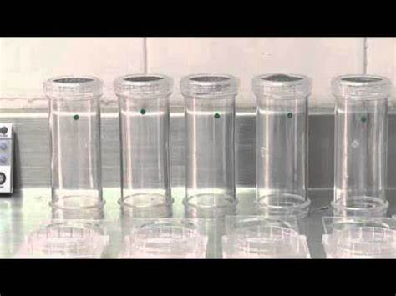
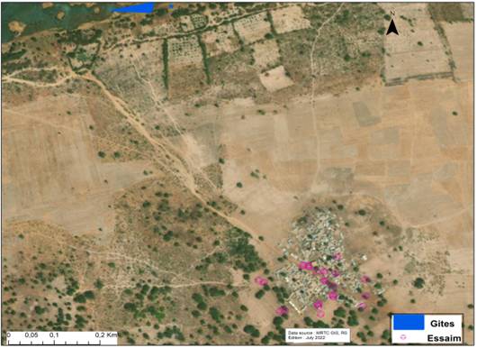
AIM#1: To reduce by more than 50% the densities of Anopheles breeding sites and mosquito densities in riverbeds during prolong dry season in Sahel region of Mali
Larval habitats
Design & Methods
Intervention vs control portion
Identification and mapping
  breeding sites
  swarming markers
Analyzing
  Insecticide susceptibility profiles
  Insecticide residues in larva habitats.
Mosquito adult collection in human dwellings
Swarms

Slide 8
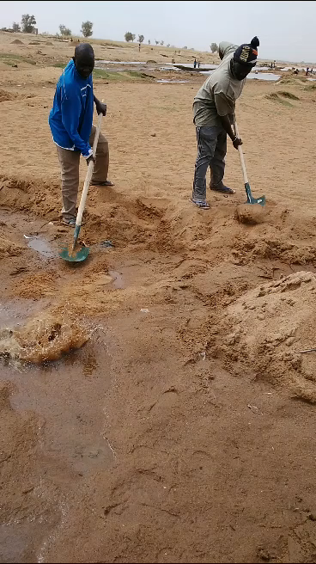
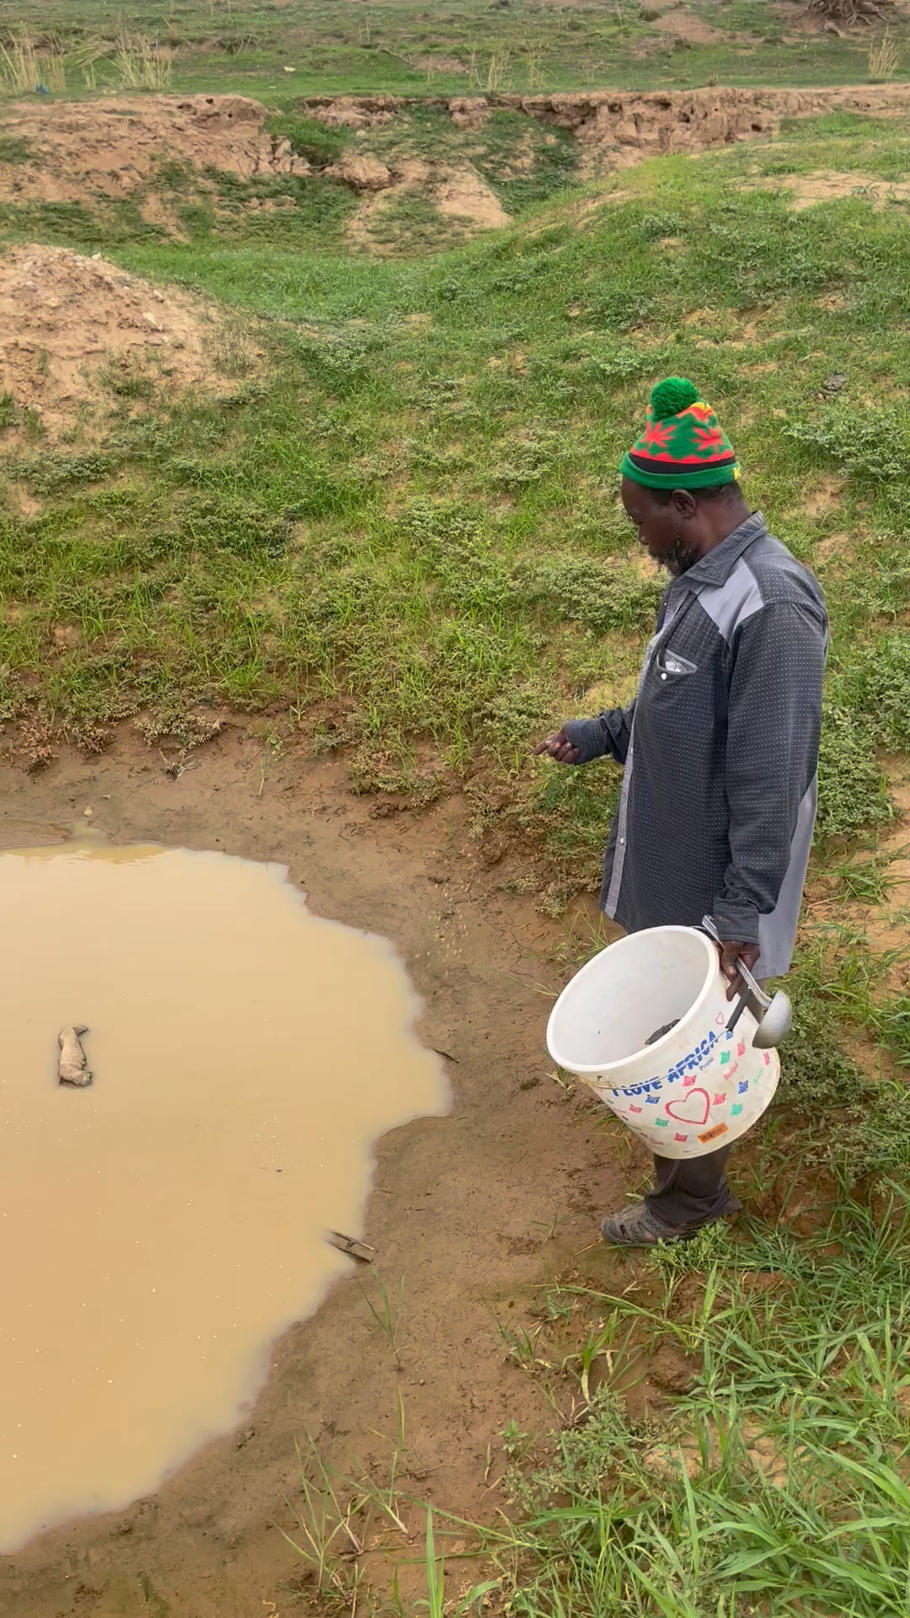

WP1: Reduction of malaria vector densities associated with River beds during long dry seasons in Sahel region of Mali
Interventions: every 15 days
Physical destruction
Larviciding (Bti)
Swarms killing

Slide 9
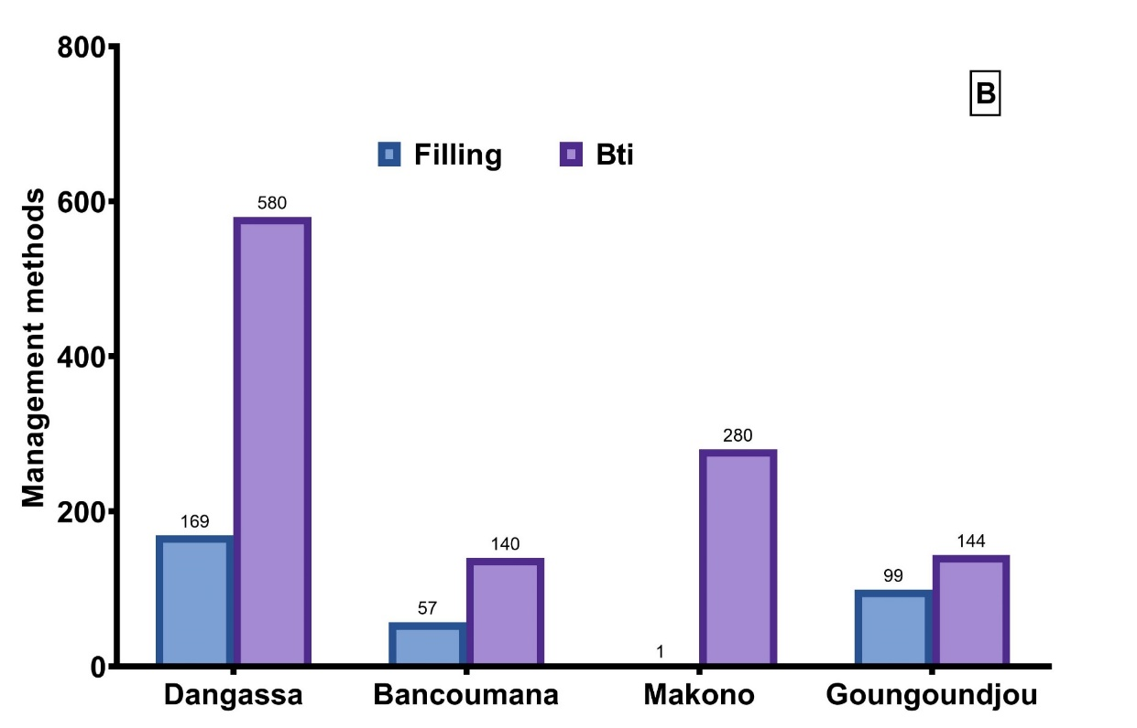
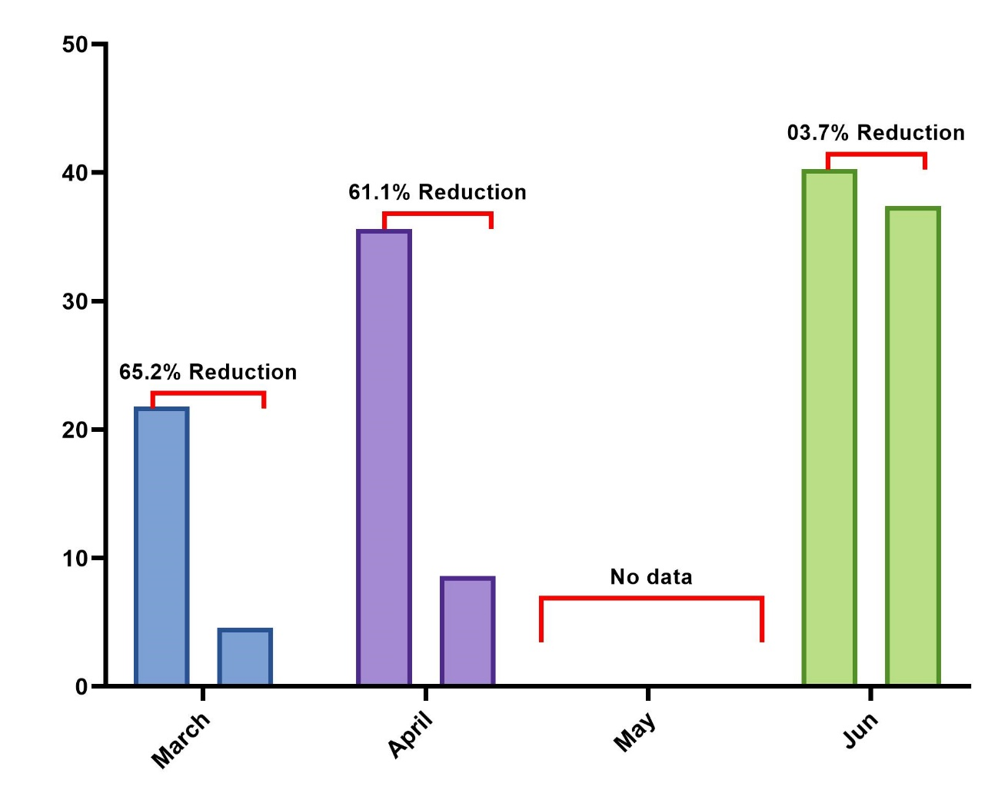
WP1: Reduction of malaria vector densities associated with River beds during long dry seasons in Sahel region of Mali
Figure xx: Frequency of the different types of larval habitats in the intervention portion
1,587 larval habitats identified in the intervention portion
Two types: brick pits and water pools
1,144 were treated with Bti
326 were filled in with sand

Slide 10
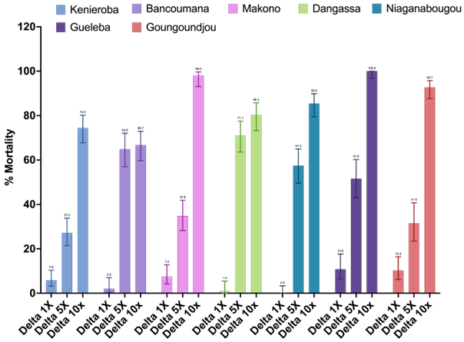
WP1: Reduction of malaria vector densities associated with River beds during long dry seasons in Sahel region of Mali
Table. Detection of insecticide residues in An. gambiae s.l. larval habitats during the dry season
Localities | Sample types | Insecticide residues detected
Gueleba | Soil | Heptachlor, Deltamethrin, DDT
 | Water | Heptachlor, DDT
Kenieroba | Soil | Heptachlor, Deltamethrin, DDT
 | Water | Heptachlor
Dangassa | Soil | None
 | Water | None
Niaganabougou | Soil | Heptachlor, Deltamethrin
 | Water | None
Bancoumana | Soil | Deltamethrin, DDT
 | Water | None
Makono | Soil | Heptachlor, Deltamethrin
 | Water | None
Goungoundjou | Soil | Heptachlor
 | Water | None

Slide 11
Conclusion
Two types: brick pits and water pools
Larval control and swarm killing reduced up to 60% the mosquitoes densities in human dwellings
Pesticide residues were found in both larval habitats water and soil
Anopheline mosquito population were highly resistant to both pyretroids and Carbamates.

Slide 12
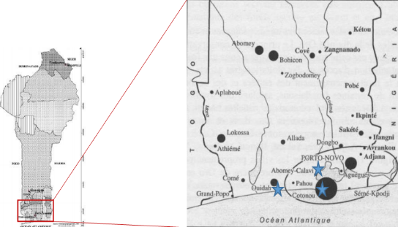
AIM#2 To reduce by more than 50% the amount of insecticide residues in soil and water (Anopheles breeding sites) compartments in vegetable production sites of Benin.
Study sites
The study was conducted in urban settings of Cotonou, Abomey-Calavi and Ouidah where vegetable cropping is important:
  3 control sites free of synthetic pesticides before experimentation
  3 test sites under synthetic agro-insecticides

Slide 13
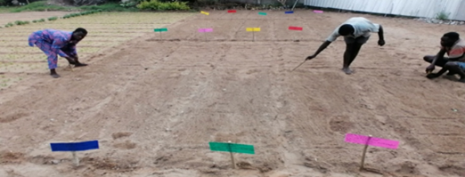
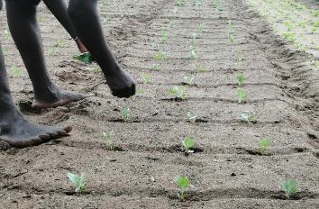
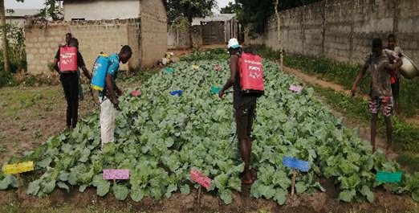
AIM#2. To reduce by more than 50% the amount of insecticide residues in soil and water (Anopheles breeding sites) compartments in vegetable production sites of Benin.
Design & Methods
Tillage, land preparation and fertilization
Transplanting of healthy & uniform seedling
Tc: Control (Farmers practices)
T1: Emacot (Emamectin benzoate) @ 0.7 g/liter water at seven-day intervals.
T2: Lambdace (Lambda-cyhalothrin + Acetamiprid) @ 2.0 ml/liter water at seven-day intervals.
T3: Emacot + Lambdace (Lambda-cyhalothrin + Acetamiprid + Emamectin benzoate) @ 0.35 g & 1.0 ml, respectively, per /liter water at seven-day intervals.
T4: Emacot/Lambdace (Lambda-cyhalothrin + Acetamiprid + Emamectin benzoate) @ 0.7 g & 2.0 ml/liter water alternatively at seven-day intervals.

Slide 14
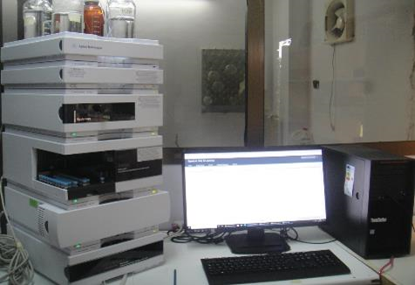
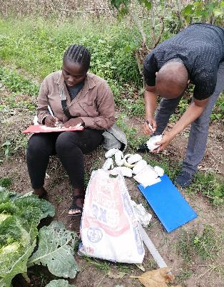
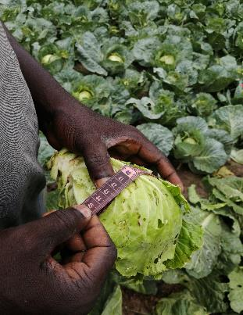
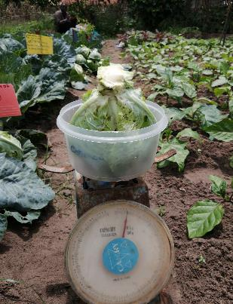
AIM#2. To reduce by more than 50% the amount of insecticide residues in soil and water (Anopheles breeding sites) compartments in vegetable production sites of Benin.
Design & Methods
Agronomic parameters collection
Pesticides residues extraction and quantification
HPLC machine (Djouaka et al. 2018)
The QuEChER method (AOAC, 2005) and HPLC machine (Djouaka et al. 2018)

Slide 15
AIM#2. To reduce by more than 50% the amount of insecticide residues in soil and water (Anopheles breeding sites) compartments in vegetable production sites of Benin.
RESULTS: agronomic parameters
Conclusion: T3= T1/2 + T2/2 presented the low insect pressure and the best yield.

Slide 16
RESULTS: Pesticide residue analysis
AIM#2. To reduce by more than 50% the amount of insecticide residues in soil and water (Anopheles breeding sites) compartments in vegetable production sites of Benin.
Emamectin Benzoate residues found is over than the maximum residues level (MRLs)
MRLs = 0.02 µg/ml

Slide 17
RESULTS: Pesticide residue analysis
AIM#2. To reduce by more than 50% the amount of insecticide residues in soil and water (Anopheles breeding sites) compartments in vegetable production sites of Benin.
Acetamiprid residues found is over than the maximum residues level (MRLs)
MRLs = 0.7 µg/ml

Slide 18
RESULTS: Pesticide residue analysis
AIM#2. To reduce by more than 50% the amount of insecticide residues in soil and water (Anopheles breeding sites) compartments in vegetable production sites of Benin.
λ-cyhalothrin residues found is over than the maximum residues level (MRLs)
MRLs = 0.3 µg/ml
Pesticides residues analysis (λ-cyhalothrin)

Slide 19
Conclusion
Agronomic parameters
Pesticides residues analysis
≠
T3: Emacot/2 + Lambdace/2 (Lambda-cyhalothrin + Acetamiprid + Emamectin benzoate) @ 0.35 g & 1.0 ml, respectively, per /liter water at seven-day intervals.
T4: Emacot/Lambdace (Lambda-cyhalothrin + Acetamiprid + Emamectin benzoate) @ 0.7 g & 2.0 ml/liter water alternatively at seven-day intervals.
Low
insect pressure
High production yield
Low pesticides residues
Famer´s practices

Slide 20
Challenges faced during the project implementation and lessons learned
How to maintain the multisectoral advisory task force working after the end of the project?
How to map the success of MSA interventions to a given MSA pillars
Difficulties in synchronizing programs of different stakeholders
How to ensure research results are taken up into policies, especially in the case of cross-sectoral policies.

Slide 21
Thank you for your attention

