Slide 1
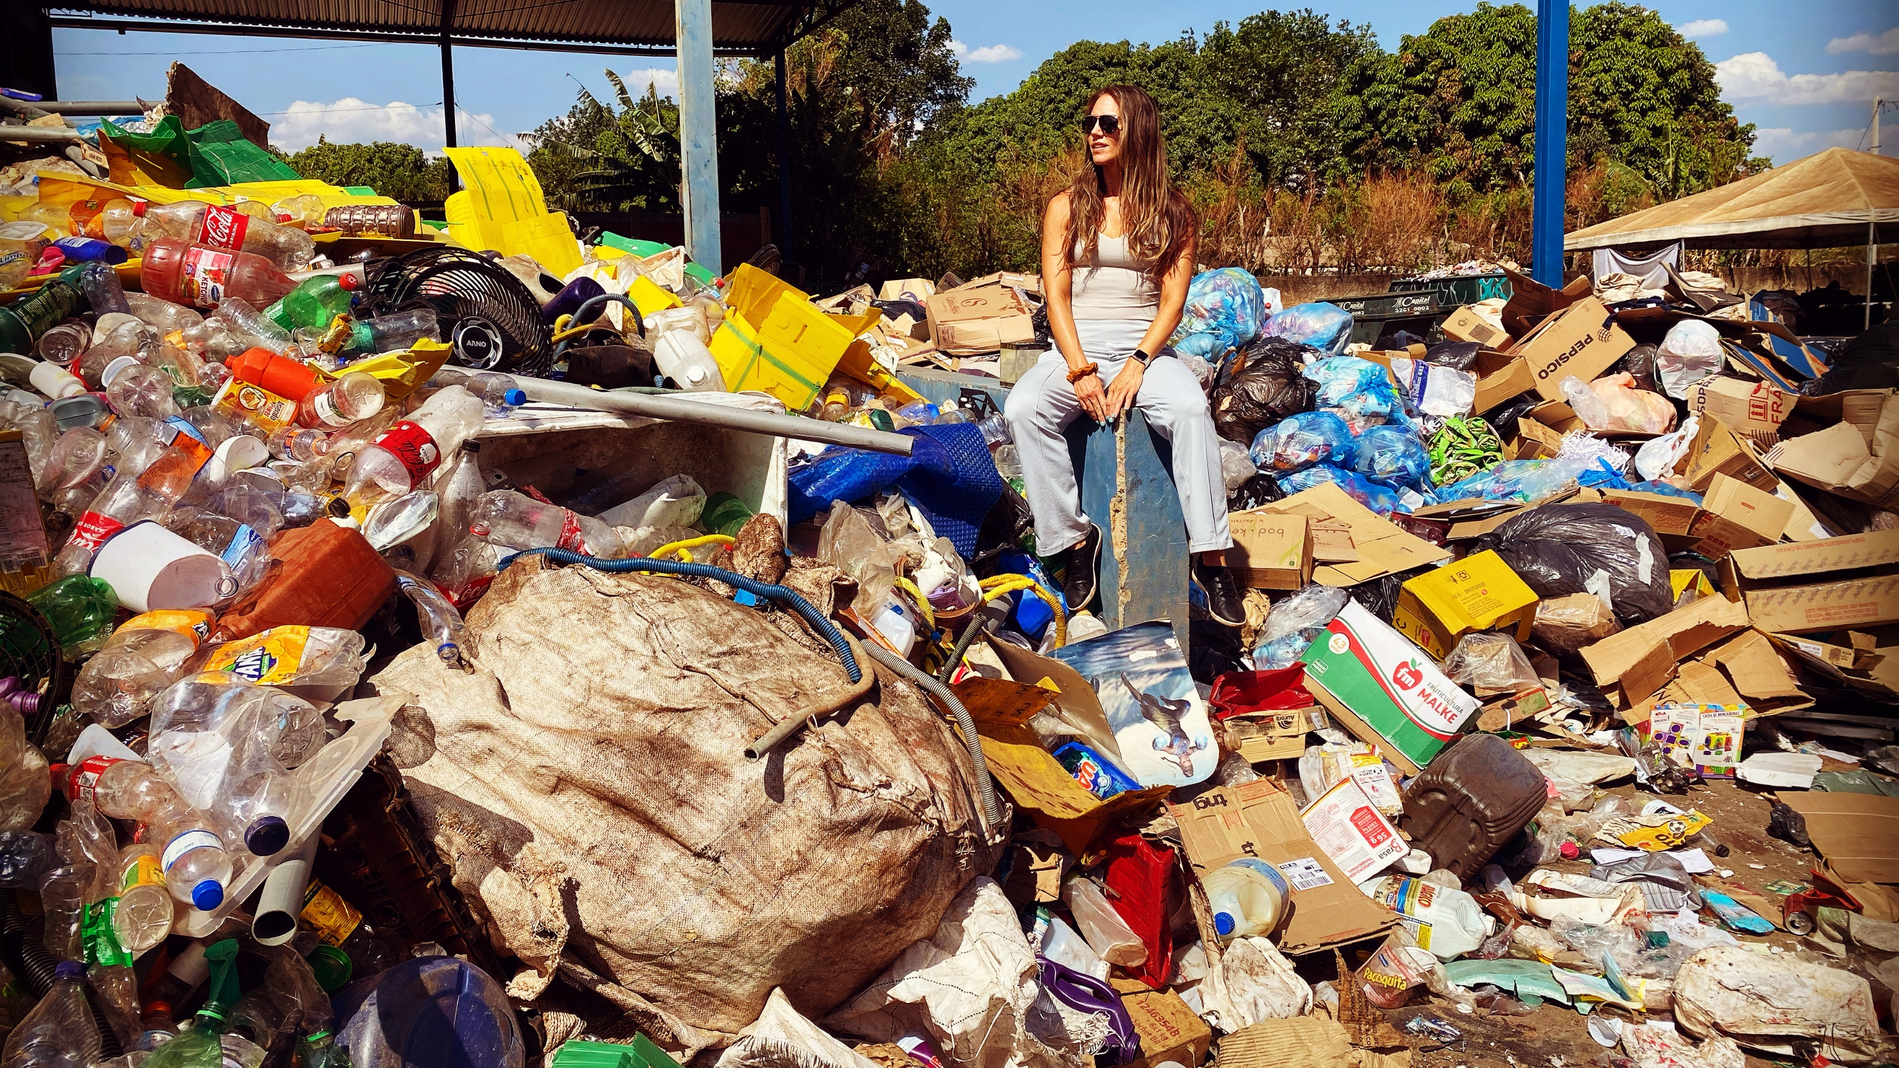
“Look, it’s a dengue mosquito”: A qualitative study on open-air dumpsites and vector-borne diseases
By Tara Rava Zolnikov^{1,2*}
And Tanya Clark², Frances Furio³, Sandul Yasobant⁴, Ana Carolina Silva Martins⁵, Vanessa Resende Nogueira Cruvinel⁶, and Marcos Obara⁷
¹ National University, Department of Community Health, San Diego, CA
²California Southern University, School of Behavioral Sciences, Costa Mesa, CA
³California State University, Sacramento, Sacramento, CA
⁴Institute for Hygiene & Public Health, University Hospital Bonn, Germany
^{5,6,7}University of Brasilia, Brasilia, Brazil

Slide 2
Waste pickers
Exposures: biological
(e.g., communicable diseases from needle sticks, bioaerosol inhalation, vector-borne diseases), physical (e.g.,musculoskeletal injuries, heat stress) and chemical (e.g. burns, toxic exposures)
Hazards, psychosocial (e.g., stigma), ergonomic (e.g., respective movement, poor posture).

Slide 3
Estructural dumpsite, Brasilia, Brazil
Structural City in Brazil has been the site of the largest open-air dumpsite in South America for more than 60 years.
Estructural dumpsite not only was this the second largest dumpsite in the world, but it was also considered the most unsanitary in Brazil.
It is located 15 km from the Center of Brasília, close to the Brazilian National Park (a conservation area) and the Cabeceira do Valo river, where residents often farm vegetables and fruits.
Around the Estrutural garbage dump, there is a large area of environmental degradation, which is exacerbated by social conflict originated by the construction of shanty houses inhabited by the waste pickers.
During its operation, Structural received a full spectrum waste type and also served as a site for waste pickers to scavenge recyclable materials that could be traded for money.

Slide 4
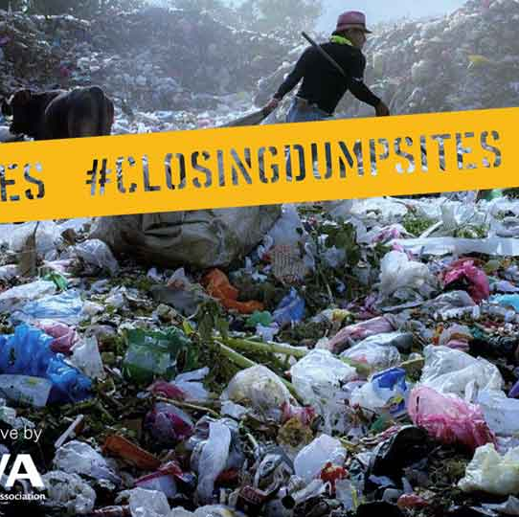
Formal dumpsite closure.
Closed in 2017.
In Brazil, there remain 3000 active dumpsites where waste pickers continue to work.

Slide 5
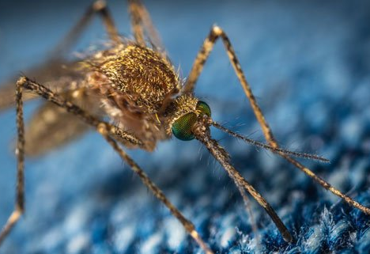
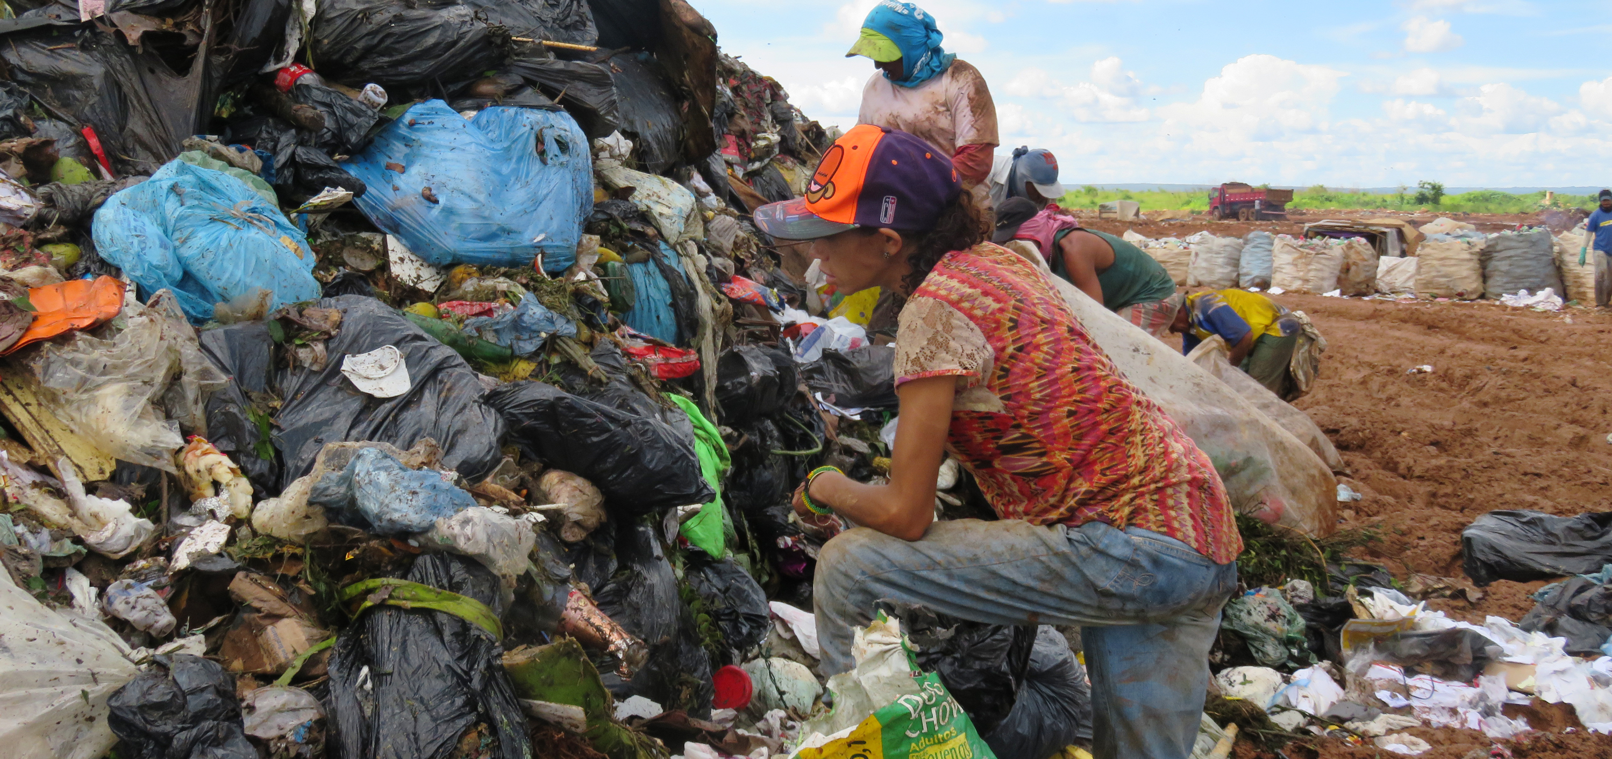
Dumpsite environment.
. The lack of selective garbage collection and inadequate water storage are important factors in the dynamics of vector-borne transmission.
In general, open-air dumpsites serve as important breeding sites of the mosquitoes in spite of the poor environmental conditions associated standing pools of water, inadequate sanitation, and more.

Slide 6
A qualitative study.
Previous research on waste pickers has focused on vector-borne diseases, their exposure, and mitigation strategies.
A phenomenological qualitative study was conducted in order to understand the experiences of waste pickers and nearby populations regarding community knowledge on mosquitos, contributing and prevention measures, and water access.
Data was collected via semi-structured interviews that lasted approximately 30 to 60 minutes.
Data was then transcribed and translated.
Analysis occurred through hand-coding where code words were identified into later themes.
This study was funded by the World Health Organization TDR grant and approved by University of Brasilia ethics committee and the WHO ethics committee.

Slide 7
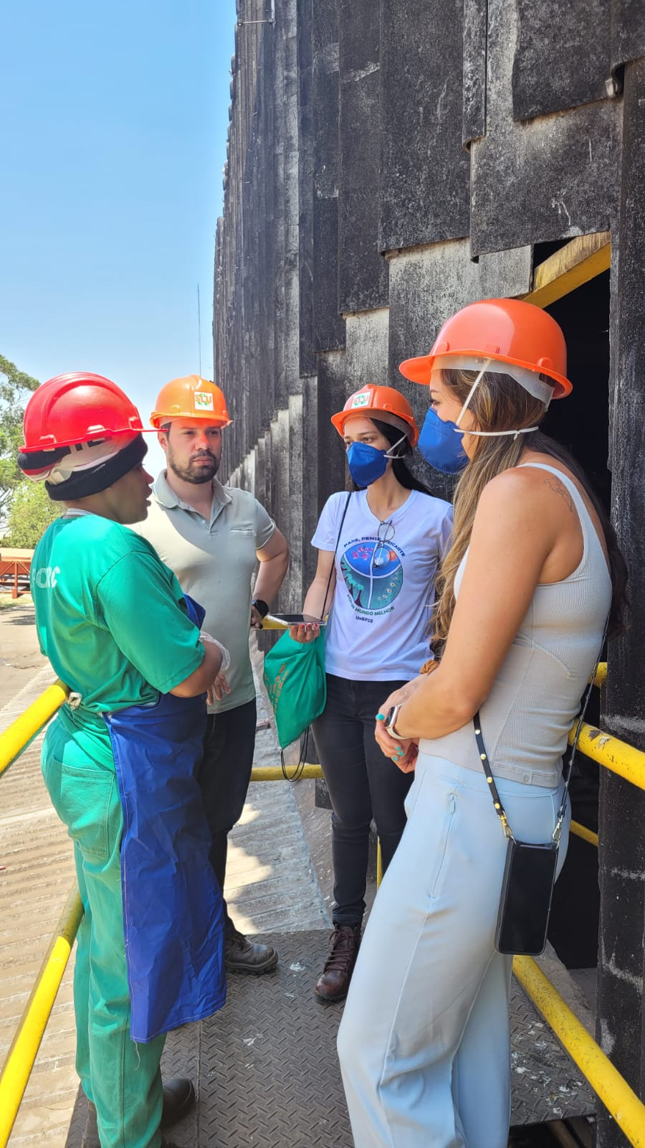
Participants
There were 126 waste pickers and people living nearby former Estructural open air dumpsite that participated in this study.

Slide 8
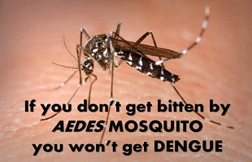
Results
Participants mentioned contributing factors to the disease and knowledge on vectors, identifying mosquitos that carry dengue, and how often and how specifically it was to have dengue.
They also mention preventative techniques that they currently take and strategies to improve upon these

Slide 9
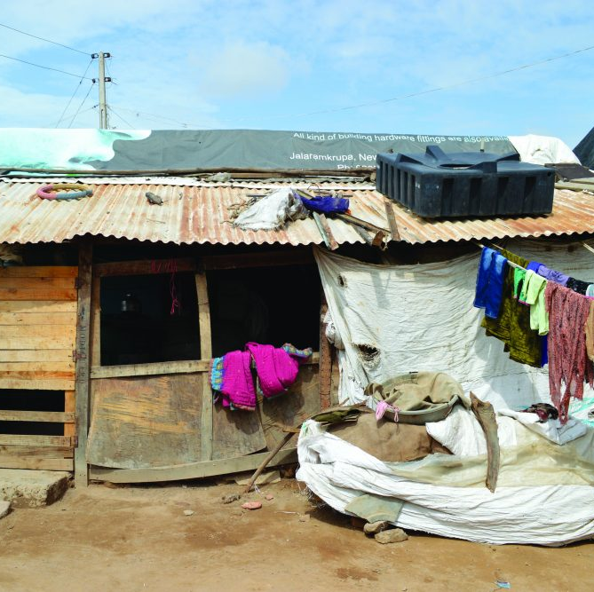
The built environment.
The built environment in slums or favelas can contribute to transmission of disease. This is due to high levels of contamination through poor sanitation, unimproved water sources, and unregulated waste alongside overcrowding and poor housing structures (e.g., no windows or doors). The Santa Lucia favela was described as “mud, rain, dust… there’s no water to pump.” (1.9) and how “…the lack of hygiene [garbage] of people who [also] leave water accumulated…all of this influences exposure.” (2.16)

Slide 10
Knowledge
Because participants are exposed to diseases, especially cases of dengue, they can easily identify it and know when they have contracted it. “There are many cases of disease [here], especially dengue.” (2.4) They are frequently sick from disease exposure, “we get sick all the time.” (1.1) Because of the frequency of contraction, dengue gets worse over time and waste pickers can become very ill.
Participants have so much knowledge on the disease that they can even distinguish the mosquito that carries dengue, Aedes aegypti. “My husband also saw a mosquito very similar to the dengue mosquito; he caught it and showed it to me and said, ‘look, here it’s [a] dengue mosquito.’” (2.14) Because they can spot the mosquito that carries the virus, they are able to react accordingly when they see it. “When we see them, we poison them.” (2.10).

Slide 11
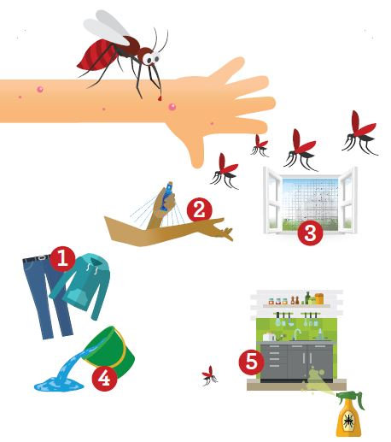
Prevention
Strategies included: “bleach…then we always take care of [water treatment] … store water and [keep it in the fridge]…only recycle the water from washing clothes…but the water [thrown to plants] is very little… there is [some water for the] dogs there, but their water is changed every day and the water container is small. (2.13)
Other strategies included “repellent on children” (2.11), “plug in the outlet [repellent against mosquitos]” (2.14), “the mosquito coil to burn [and[ I also put poison, Baygon (brand of insecticide) out.” (2.15), and “put up screens.” (1.2) Many times the repellent and tools are frequently used when children are around, “I use repellent on my children.” (1.2)

Slide 12
Future Solutions
Education and support were highlighted, “there has to be an awareness.” (1.2) It was also suggested to improve awareness through health agents, “the health agents have to visit more [often]; they only visit once a month.” (2.9). It was mentioned how the government needed to become more actively involved in fighting disease and addressing health, “the biggest [contributor to the disease exposure] is the government... they don’t want to spend [money] on health; they don’t want to spend [money] on medicine to fight the mosquitoes. The only [prevention] we have is the fumigation spray.” (2.13)
Participants understood that avoiding vector-borne diseases (e.g., taking care of mosquitos, decreasing pools of standing water or areas where garbage builds up, using fumigation strategies) is difficult. “The problem is that we don’t have enough time to take care of things, the time to take care of the garbage, the environment…”

Slide 13
Discussion
Despite the closure of the open dump in Estrutural city in Brasilia, Brazil, the waste pickers and other populations still live with their families in the proximities of the area.
The built environment, poor sanitation, unimproved water sources, and unregulated waste alongside overcrowding and poor housing structures are contributing factors.
Waste pickers are one group of people who frequently suffer from dengue. Because of the familiarities of dengue among this population, waste pickers are highly knowledgeable about the symptoms of the disease. This phenomenon could be perceived in two ways: 1. knowing about the symptoms enables waste pickers to seek healthcare or 2. preventing dengue amongst the frequent onset of the disease results in decreased immunity among these vulnerable groups resulting in low productivity and subsequent socioeconomic loss.
Combine waste management and clean-up campaigns and eliminate breeding sites. Continued fumigation along with health education is one of the key measures that could be taken as a mitigation strategy near garbage sites; thus, the partnering of a macro-approach (e.g., waste management) alongside a person-centered (e.g., home fumigation) approach can be used simultaneously to achieve the most effective results.

Slide 14
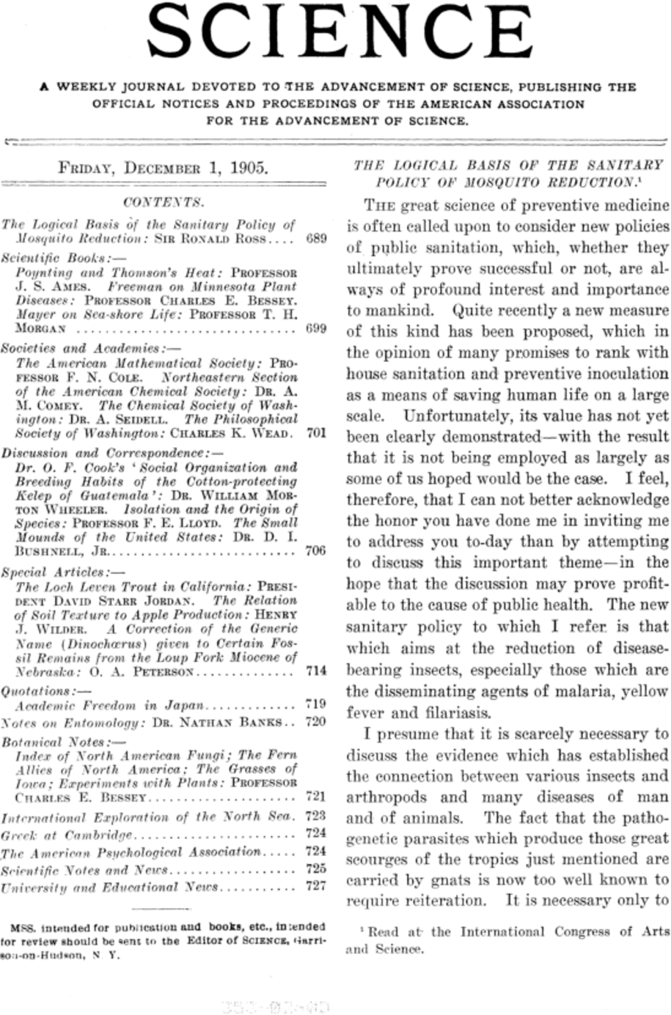
Future Research
Future research could seek to understand how policy measures could align with public health interventions, as identified by the needs of waste pickers, including expanded education, the value of organized labor, increased government spending to fight mosquitos, and improved housing as solutions to decrease or eliminate disease. The current study reinforces research that shows that promoting individual behavioral changes can enhance community health

Slide 15
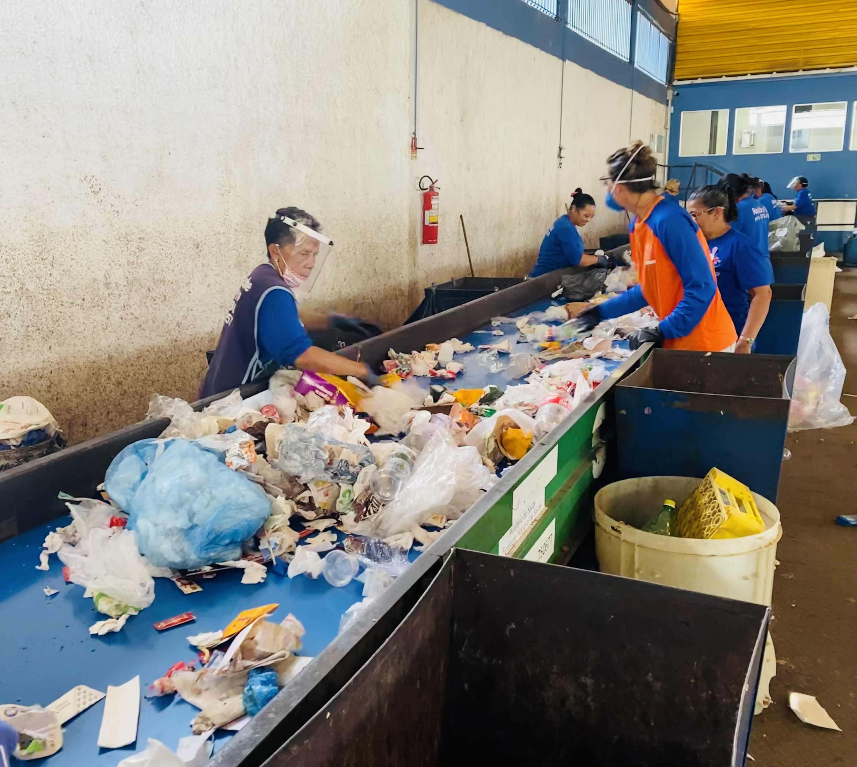
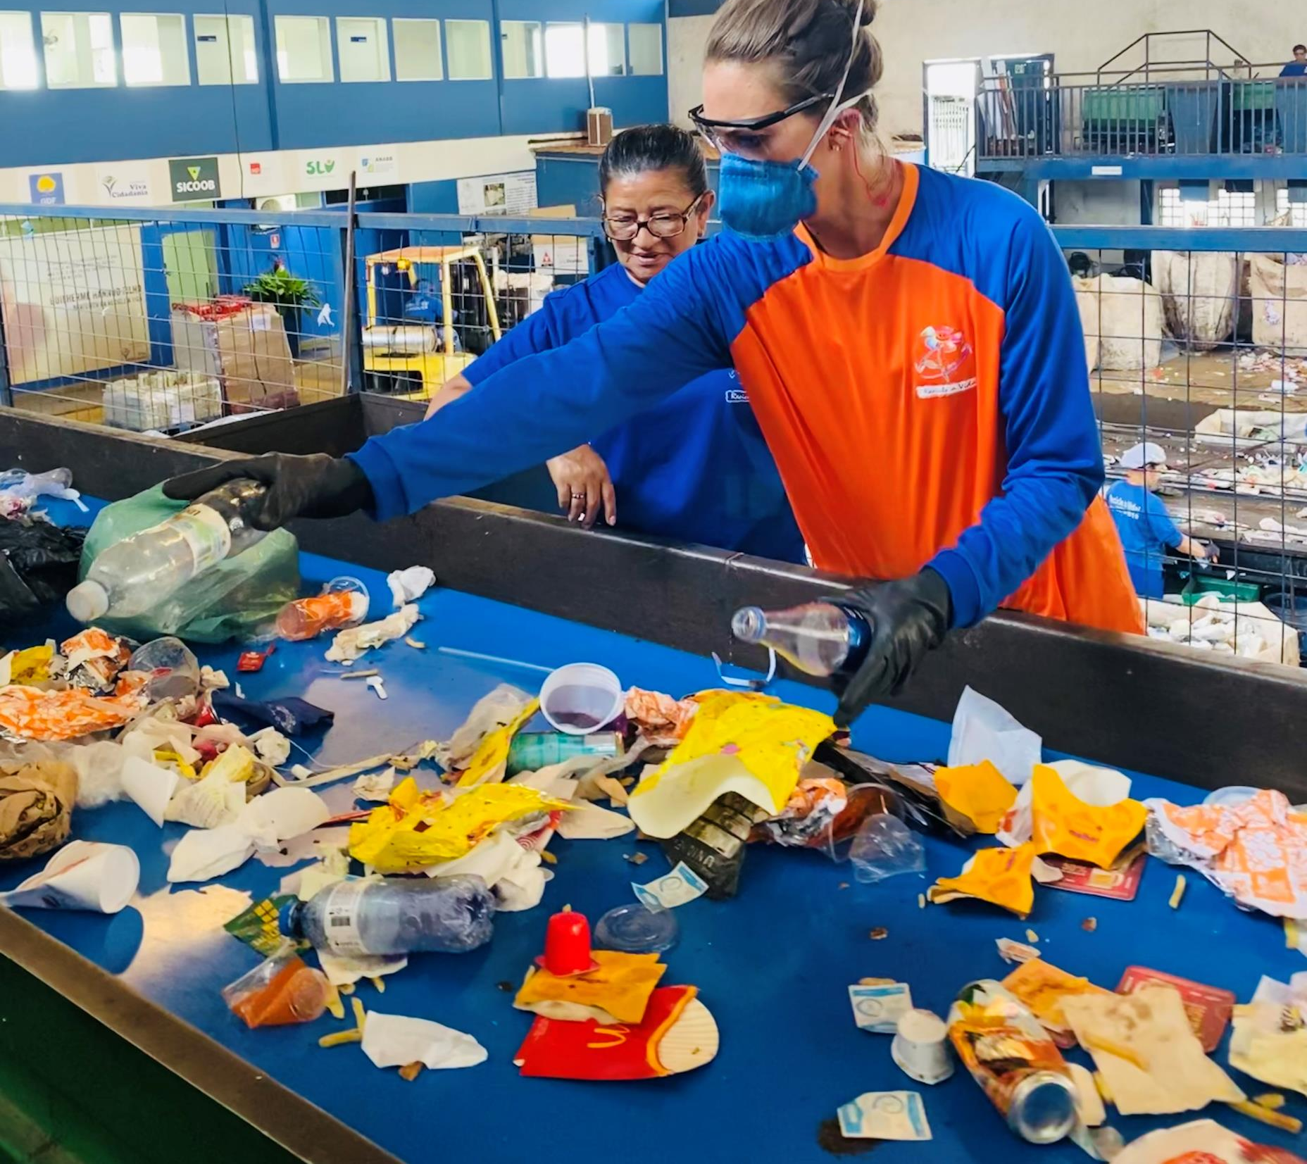
Thank you!
Email: tarazolnikov@gmail.com

Slide 16
Applicable Publications
Zolnikov, T.R. et al. (2023). “Look it’s a dengue mosquito”. Qualitative Study on Living Near Open-Air Dumpsites and Vector-Borne Diseases. Advances in Environmental and Engineering Research, 4(3). doi: doi:10.21926/aeer.2303045
Zolnikov, T.R. (2022). Stop treating waste pickers like garbage: An autoethnography on informal waste picking. Journal of Global Health.
Rosa KD, Zolnikov TR, Leite TS, Caldas S, de Souza Filho A, Jacob RS, Mol MPG. (2022). Visceral Leishmaniasis and Disposal of Solid Waste in Minas Gerais, Brazil. Advances in Environmental and Engineering Research, 3(3), 028, doi:10.21926/aeer.2203028.
Mol, M. P. G., Zolnikov, T. R., Neves, A. C., Dos Santos, G. R., Tolentino, J. L. L., de Vasconcelos Barros, R. T., & Heller, L. (2022). Healthcare waste generation in hospitals per continent: a systematic review. Environmental Science and Pollution Research, 1-10.
Souza-Silva, Zolnikov, T.R., Ladeira, O. Cruvinel, V., Dias, S. (2021). Hepatitis B and C prevalence in waste pickers: A global meta-analysis. Journal of Public Health. doi: 0.1093/pubmed/fdab285
Zolnikov, T.R., Pezeshkian, F., Rodriquez, P., Stoves-Tucker, L., Cruvinel, V., Pintas, C., Galato, D. (2021). A qualitative study on chronic noncommunicable diseases and waste pickers in Brazil. Journal of Heath and Pollution. 11(30), doi: 10.210603.
Zolnikov, T.R., Furio, F., Cruvinel, V., & Richards, J. (2021). A systematic review on informal waste picking: Occupational hazards and health outcomes. Waste Management, 126, 291-308. doi: 10.1016/j.wasman.2021.03.006
Santos, F., Zolnikov, T.R., Ribas, I., Casabona, J., Monteiro, E., Martins, E., Franca, D., Aruajo, W., & Cruvinel, V. (2020). Syphillis and other sexually transmitted infections among waste pickers in Brasilia, Brazil. Waste Management, 118, 122-130. doi: 10.1016/j.wasman.2020.08.040
Marques, C.P., Zolnikov, T.R., Noronha, J., Angulo-Tuesta, A., Bashashi, M., & Cruvinel, V. (2020). Social vulnerabilities of female waste pickers in Brasilia, Brazil. Archives of Environmental and Occupational Health, 1-8. doi: 10.1080/19338244.2020.1787315
Pataca, L.C.M., Pedrosa, M.A.F., Zolnikov, T.R., & Mol, M. (2020). Water quality index and sanitary and socioeconomic indicators in Minas Gerais, Brazil. Environmental Monitoring and Assessment, 192(7), 1-12. doi 10.1007/s10661-020-08425-9
Zolnikov, T.R., Ramos, H.M.P., Cruvinel, V.R.N., Bashash, M. Scott, J. (2020). Vector-borne diseases in waste pickers in Brasilia-Brazil. Waste Management. 105, 223-232. doi: 10.1016/j.wasman.2020.02.001
Cruvinel, V.R.N., Zolnikov, T.R., Bashash, M., Marques, C.P., Simoes, A.S.R., & Scott, J. (2019). Waterborne diseases in waste pickers of Structural, Brazil, the second largest open-air dumpsite in the world. Waste Management, 99. 71-78. doi:10.1016/j.wasman.2019.08.035
Zolnikov, T.R., Ramos, H.M.P., Cruvinel, V.R.N., Guimaraes, A.D., Galato, D. (2019). Medical waste disposal in Brasilia, Brazil: A Qualitative study on adverse health outcomes of recyclable waste collectors. Journal of Environmental Health and Pollution, 9(23). 1-10. doi: 10.5696/2156-9614-9.23.190905
Scarponi, C., Zolnikov, T.R., Mol, M. (2019). Are waste pickers at risk for hepatitis B and C infections because of poverty or environmental exposures? Journal of Brazilian Society of Tropical Medicine, 52. doi:10.1590/0037-8682-0123-2019
Zolnikov, T.R., Costa de Silva, R., Tuesta, A.A., Marques, C.P., Cruvinel, V.R.N. (2018). Ineffective waste site closures in Brazil: A systematic review on continuing health conditions and occupational hazards of waste collectors. Waste Management, 80, 26-39. doi: 10.1016/j.wasman.2018.08.047

