Slide 1
Networking in vector control against vector-borne diseases
Samuel Kweku Dadzie, PhD

Slide 2
Outline of presentation
Burden of Vector-borne diseases
Challenges
Importance of Networking in control of VBDs
WAASuN as a example of Networks on Arboviruses
Conclusions and Wayforward

Slide 3
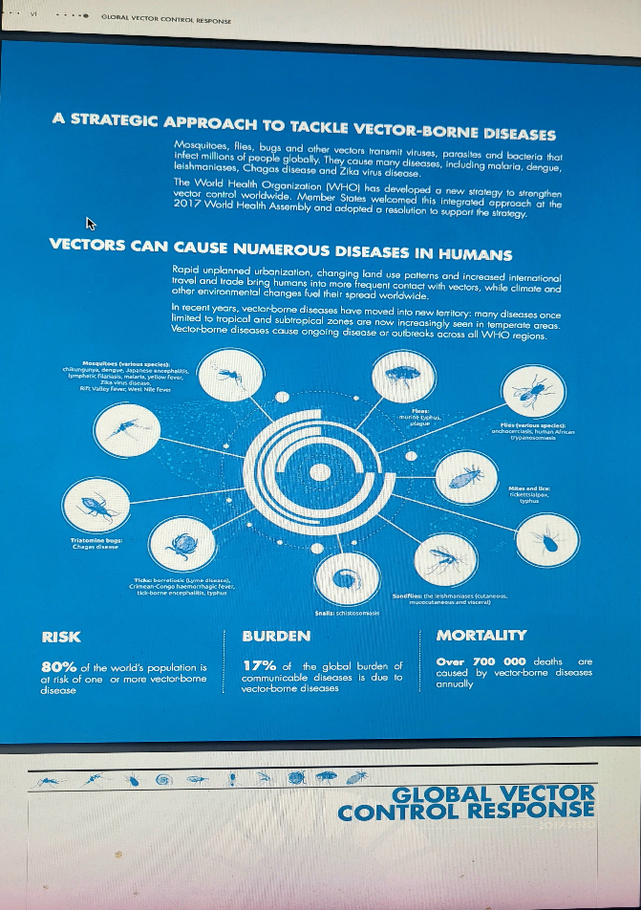
Burden of VBDs
VECTORS CAN CAUSE NUMEROUS DISEASES IN HUMANS
  RISK, 80% of the world’s population is at risk of one or more vector-borne disease
  BURDEN, 17% of the global burden of communicable diseases is due to vector-borne diseases
  MORTALITY, Over 700 000 deaths are caused by vector-borne diseases annually

Slide 4
Structural challenges in the control of vector-borne diseases
Lack of political will and strong leadership-Country leadership
Inadequate communication and coordination among partners
Insufficient participation of communities
Unsustained funding and unsustainable interventions
insufficient entomological capacity for vector control programmes
poor links between organisations, and other structural requirements
Low advocacy, Resource Mobilisation and Partner Coordination

Slide 5
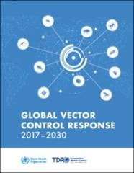
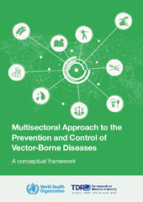
Importance of Networking in control of VBDs
Global Vector Control Response 2017-2030
  Pillars of action
    Strengthen inter- and intra-sectoral action and collaboration
    Engage and mobilize communities
    Enhance vector surveillance, and monitoring and evaluation of interventions
    Scale up and integrate tools and approaches
Global Arboviral Initiative
Multisetoral approaches to the control VBDs

Slide 6

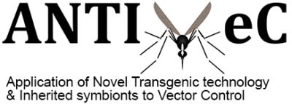







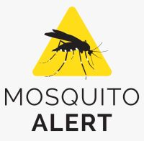



Networks for vector control

Slide 7
Networking for control of VBDs (Arboviral diseases)
Networks already existing that provide some support for arbovirus issues (Braack et. al. 2023)
  Africa Centres for Disease Control and Prevention (Africa CDC)
  African Gene Drive for Vector Control (AGDVC) network
  Global Vector Hub
  Pan-African Mosquito Control Association (PAMCA)
  Partnership for Increasing the Impact of Vector Control (PIIVeC)
  Prepare4VBD
  Southern African Centre for Infectious Disease Surveillance (SACIDS)
  West African Aedes Surveillance Network (WAASuN),
  Worldwide Insecticide resistance Network (WIN)
  Pasteur Institut network

Slide 8
Importance of Networking in control of VBDs
Enhances communication within the scientific community and stakeholders and increase synergies
Promotes awareness on emerging diseases and vector control with public authorities, researchers, citizens, existing networks.
Creates synergies and connections across the scientific community (SC) and between the SC and stakeholders.
Improve awareness creation
Increases the visibility control strategies
Support on outreaching activities
Divulgation of new tools
Support the implementation of newly developed tools and products for diagnostic and research within the scientific community of entomologists and stakeholders.

Slide 9

THE WAASUN EXAMPLE OF NETWORKING FOR AEDES SURVEILLANCE AND CONTROL
Strengthening the capacity of West African countries to control arboviral diseases

Slide 10
Key messages from Sierra Leone meeting-Dec, 2017
Lack of efficient and standardized tools for Aedes collection
Lack of good indices to determine Aedes densities that will correlate to disease outbreak
Insecticide resistance in Aedes threaten the successes of existing control strategies
Assays used for testing Insecticide resistance in Anopheles being used for Aedes may not be appropriate as insecticide tolerance may not the same for the two species
Lack of funding for Aedes surveillance studies
Lack of effective networking to address Aedes Surveillance gaps between countries

Slide 11
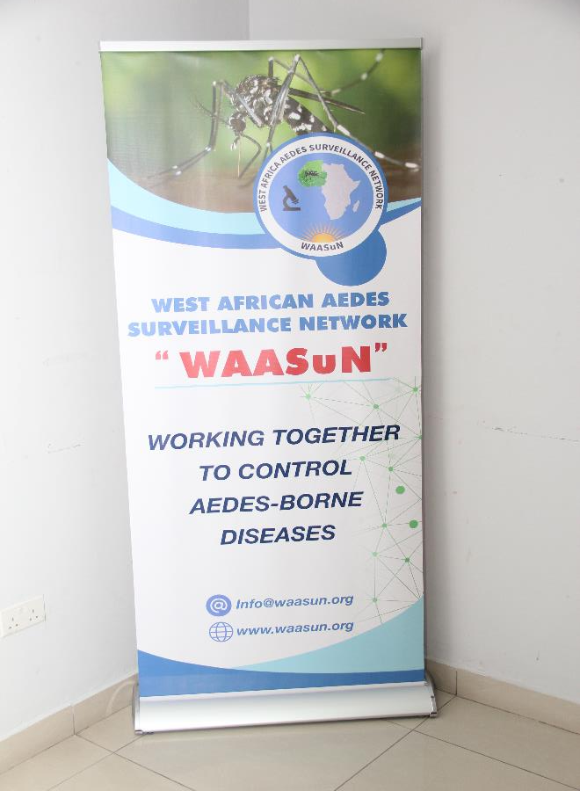
West African Aedes Surveillance Network (WAASuN)
Mission
To strengthen the capacity of West African countries to carry out surveillance and control arboviral diseases and promote regional stability and prosperity
General Objective
To network and enhance collaboration between West African countries on Aedes Surveillance
Objectives
Strengthen existing Aedes surveillance activities between countries
Bridge the gap in surveillance in the African Sub-region
Enhance the capacity building of member countries in Aedes surveillance and preparedness for disease outbreaks
Advocating for funding in support of surveillance activities

Slide 12
Status of WAASuN
WAASuN is a registered NGO in Ghana with membership but not restricted to entomologists and other public health practitioners who have interest in Aedes surveillance and control in West Africa and beyond
  Have currently over 60 members from WA + Angola, Cameroon and DRC
  Have a Chair and Co-chair, Secretary and Deputy, Executive Organizer, Financial Secretary, Media and Communication person
  Secretariat at Noguchi Memorial Institute in Ghana
  Focal persons selected in each country
  Strategic Plan developed and being implemented
Organogram

Slide 13
Key strategic areas of WAASuN
Help strengthen existing linkages in Aedes surveillance in member countries through networking
Bridge the Gap between existing surveillance system in the sub region
Build capacity of member countries surveillance activities and outbreak preparedness
Advocacy for funding in Aedes surveillance activities in Member countries
Collaboration with other partners CDC, WAHO, WHO, ANVR, WIN, PIIVEC, RAFT and Emory University

Slide 14
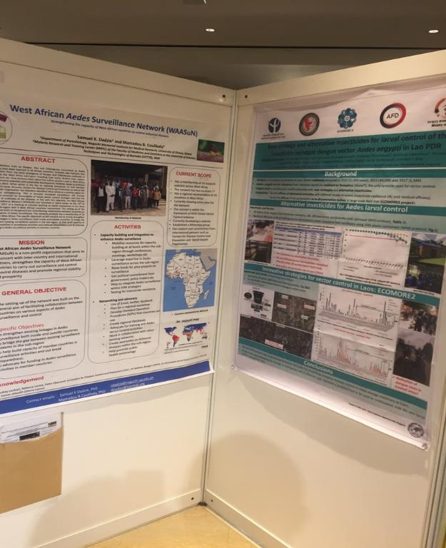
Activities (December 2017-August 2023)
Presented WAASuN at the WIN conference in Singapore, October 2018
Meeting of WAASuN members at ASTMH, Atlanta-2018

Slide 15
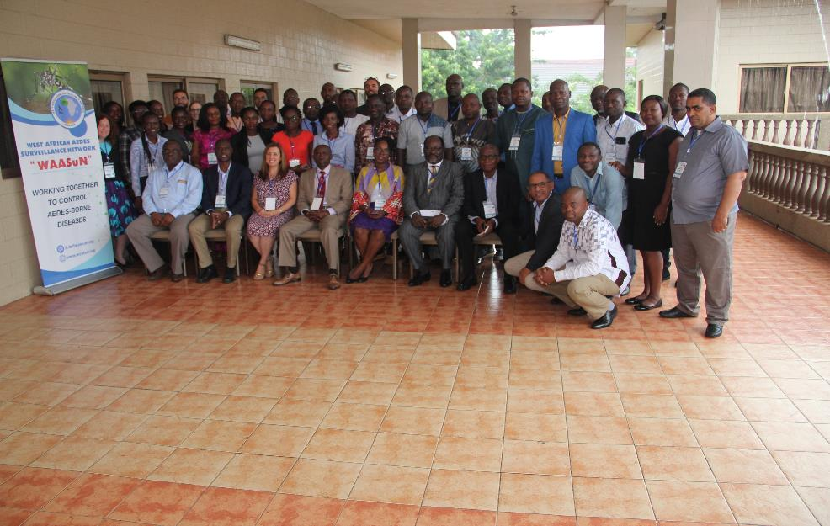
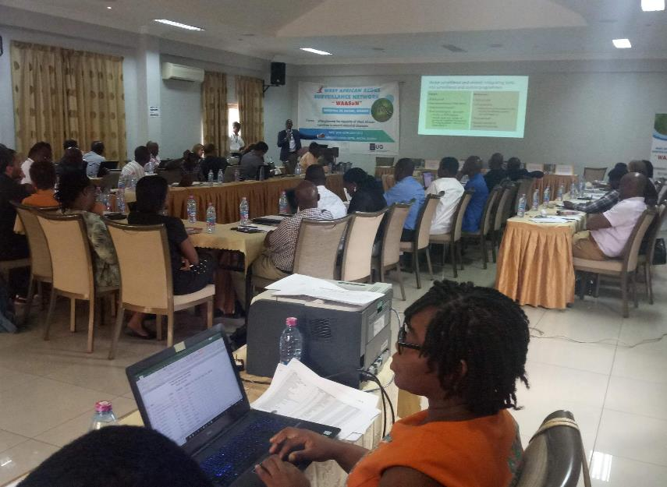
1st Regional Training Workshop in Accra, Ghana (8th -12th, July, 2019)
Theme: Strengthening the capacity of West African countries in Aedes surveillance and control
Participants from 16 West African Countries + Angola, DRC and Cameroon

Slide 16
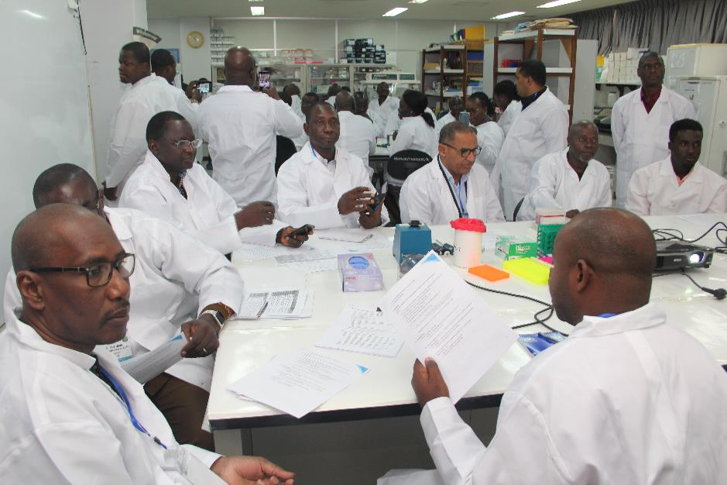
CAPACITY BUILDING EFFORTS IN WEST AFRICA
Training in insecticide resistance Monitoring in Aedes mosquitoes in Accra, Ghana-2019

Slide 17
Publication

Slide 18
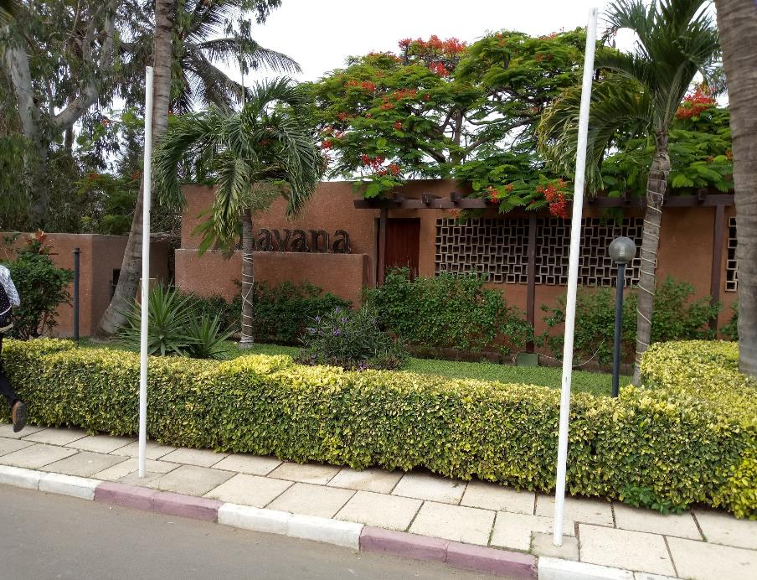
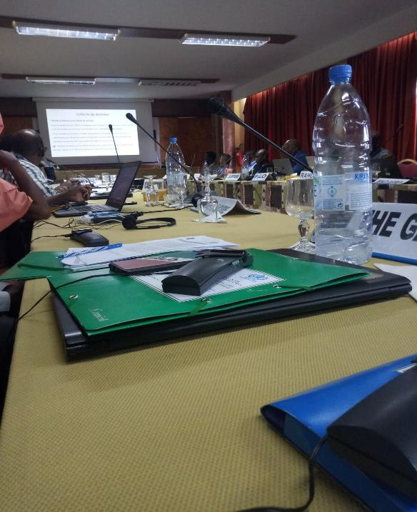
WHO/TDR/WAHO Arboviral workshop in Dakar, Senegal-July 2022
Three of our members invited to WHO/TDR/WAHO Arboviral workshop in Dakar, Senegal in July 2019
Supported the drafting of the Entomological Surveillance protocol for Arboviruses

Slide 19
Technical assistance to Cape Verde, Mauritania, Niger, Senegal, Burkina Faso, Nigeria and Cote D Ivoire for the implementation of a surveillance
Participants being taken through lectures on Entomological surveillance protocol
Meeting with the Vector Control Team of the Ministry of Health and Social Security
Participants being taken through lectures

Slide 20

SYMPOSIUM-ASTMH 2020
Aedes surveillance in Africa:
(Re-) Building capacity to address growing arboviral disease threats
Presented by:
Samuel K. Dadzie
Florence Fouque
Rebecca Levine
Mawlouth Diallo
Moderated by:
Samuel K. Dadzie
Mamadou Coulibaly
Audrey Lenhart

Slide 21
Speakers and topics
Aedes-borne arboviruses as an emerging public health threat in Africa and multi-sectoral approaches for prevention and control
Dr. Florence Fouque, WHO-TDR, Geneva, Switzerland
2. The West African Aedes Surveillance Network (WAASuN)
Dr. Samuel K. Dadzie, WAASuN President, Noguchi Memorial Institute for Medical Research, Accra, Ghana
Leveraging existing entomology capacities for malaria to address Aedes surveillance: an example from Sierra Leone
Dr. Rebecca Levine, U.S. Centers for Disease Control and Prevention, Atlanta, USA
An operational example of Aedes surveillance to improve vector control in Senegal
Dr. Mawlouth Diallo, Institut Pasteur de Dakar, Senegal

Slide 22
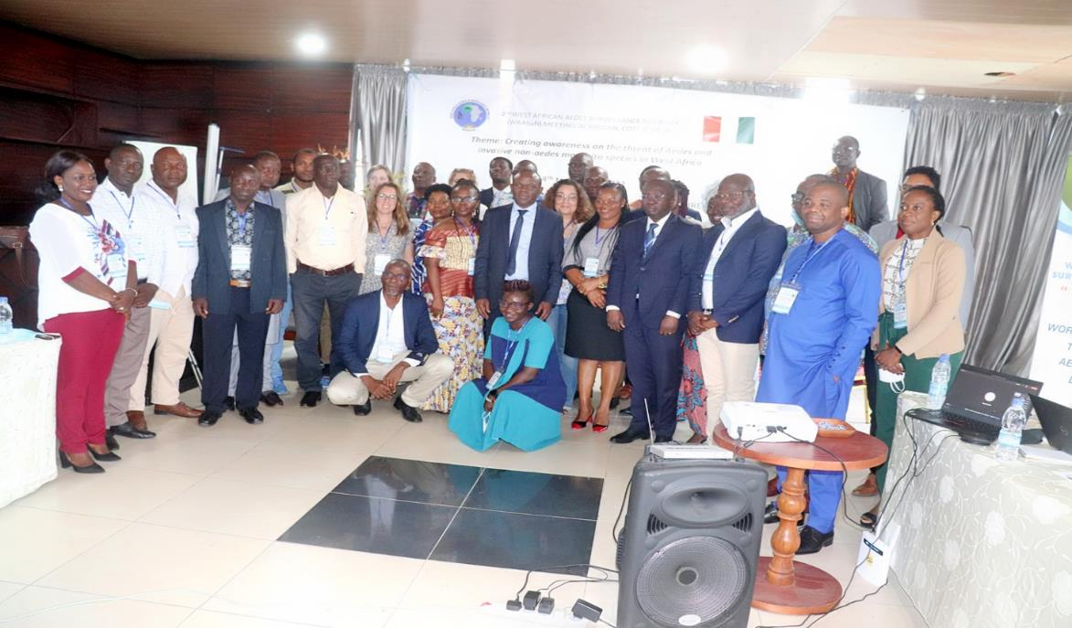
2nd Meeting in Grand Bassam, Cote D`Ivoire, July 2022
Theme: WAASuN: creating awareness on the threat of invasive non-Aedes mosquito species in West Africa
44 participants from 18 countries
RAFT members present
Training in morphological identification of A. stephensi

Slide 23
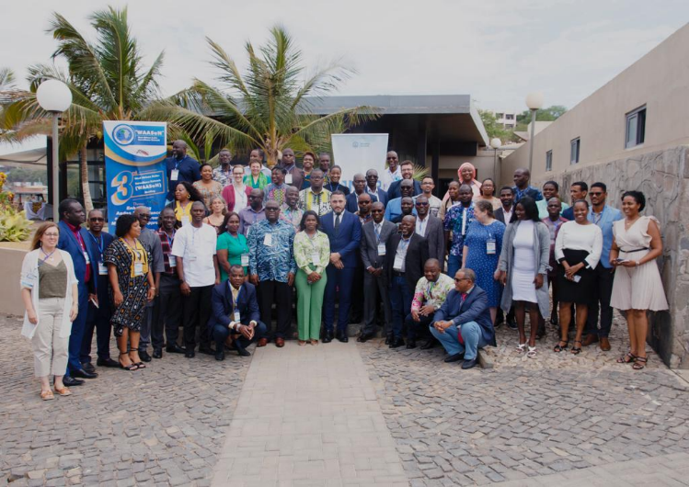
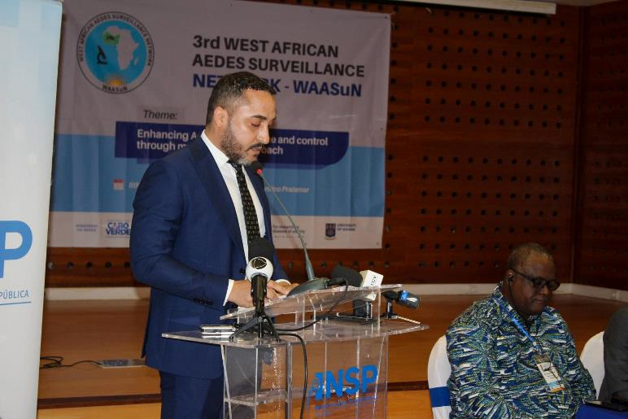
3rd Meeting in Praia, Cabo Verde- 5th-9th June 2023
Theme: Enhancing Aedes surveillance and control through multisectoral approach’
Topics
Country updates
  Resistance
  Bionomics
  Integration and of Aedes and A. stephensi surveillance and control
  Panel discussion
19 countries
70 participants

Slide 24
Progress made so far….
Organized three successful regional meetings in Accra, Ghana, Grand Bissam, Cote Dlvoire and Praia, Cabo Verde
Built capacity of over 60 participants from member countries in insecticide resistance monitoring, geo-mapping and identification of An. stephensi
Leveraged the focal persons in countries to apply for grants
Very good collaboration with WHO/TDR, WAHO, ANVR, CDC, WIN, PIIVEC etc Emory University
Successfully mobilized limited financial resources to support hosting of regional meetings
Supported WHO/TDR and WAHO to develop standard arboviral entomological surveillance protocols which is being piloted in 7 WA countries
Successfully organized a symposium at the 2020 ASTMH meeting
Supported the capacity building efforts of WHO/TDR/ WAHO in the sub-region
Started a regional project on Population genetics of Aedes aegypti (POPUGEN) project
Enhanced Aedes surveillance capabilities of member countries

Slide 25
Increased Aedes surveillance capacities of member countries
Increased Aedes surveillance capacities of countries by 76% in 6 years

Slide 26
Way forward
Networking to improve surveillance and control of VBDs within the context of MSA
We need advocacy at all levels to enhance political will and financing of surveillance and control activities
We need to escalate research to enhance our understanding of the vector bionomics
We need to engage our communities and encourage multisectoral approach in surveillance
Strengthen collaboration with other existing networks and consortium such as PAMCA, WIN, ANVR, RAFT etc
We need to build capacity at all levels to enhance control of VBDs
We need knowledge and experience sharing across regions and continents
Regional networks are important to facilitate data sharing and enhance collaboration and networking –Central, Southern, West Africa, North Africa clusters

Slide 27
Acknowledgement
WHO/TDR
All WAASuN executives and members
West African Health Organization (WAHO)
Emory University, USA
School of Public Health, University of Ghana
Ghana Health Service
Noguchi Memorial Institute for Medical Research
RAFT
CDC, Atlanta,USA (Main Funders)
WHO-TDR (supported Cabo Verde meeting)

Slide 28
THANK YOU
www.waasun.org

