Slide 1
Water, Sanitation and Hygiene sector in a multisectoral approach for control of vector-borne diseases Leonie Postma Consultant, Water, Sanitation, Hygiene and Health, WHO
TDR Training Workshop on multisectoral approaches to the prevention and control of vector-borne diseases
Saly, Senegal, 11-14 September 2023

Slide 2
WASH interventions for VBDs
Improving access to safe drinking-water supplies
Safe disposal of human excreta along the sanitation chain (from toilet to containment, transport, treatment, disposal/end use)
Handwashing with soap at critical times (broader definitions may include food hygiene, hygienic conditions for treatment and care…)
Broader scope relevant for Vector Borne Diseases especially mosquito-borne diseases:
+ Water storage practices
+ Water resource management + Solid waste disposal

Slide 3
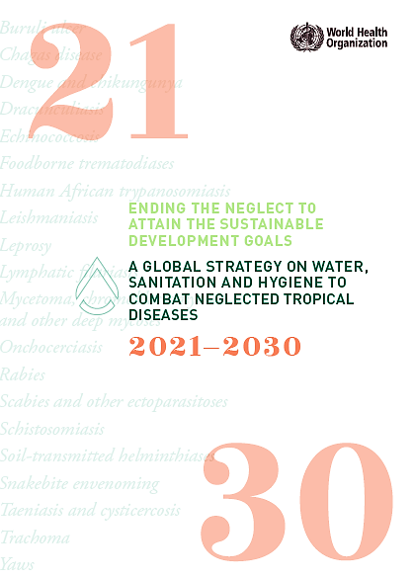
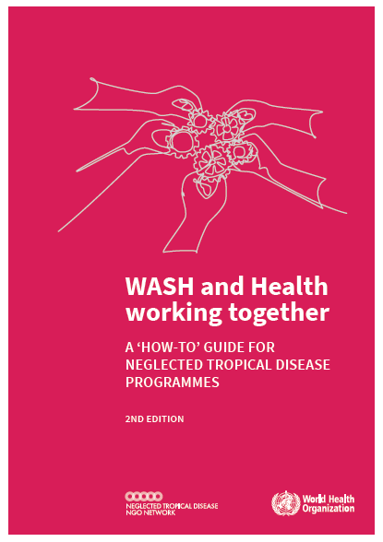
Background
Supports implementation of the NTD Roadmap & WASH-NTD Strategy 2021-2030
Eradication, elimination and control targets for 20 diseases
Includes cross-cutting targets WASH ‘achieve universal access to at least basic water supply, sanitation and hygiene in areas endemic for NTDs by 2030…’ in line with SDG 6.1 and 6.2

Slide 4
Background
We all know collaboration is important, but how do we get from “we need to do something” to “let’s do this”
The toolkit complements the MSA Framework → ‘How to’
Designed for WASH-NTD collaboration but applicable to other disease programmes
Based on tested materials and experiences from programmes

Slide 5
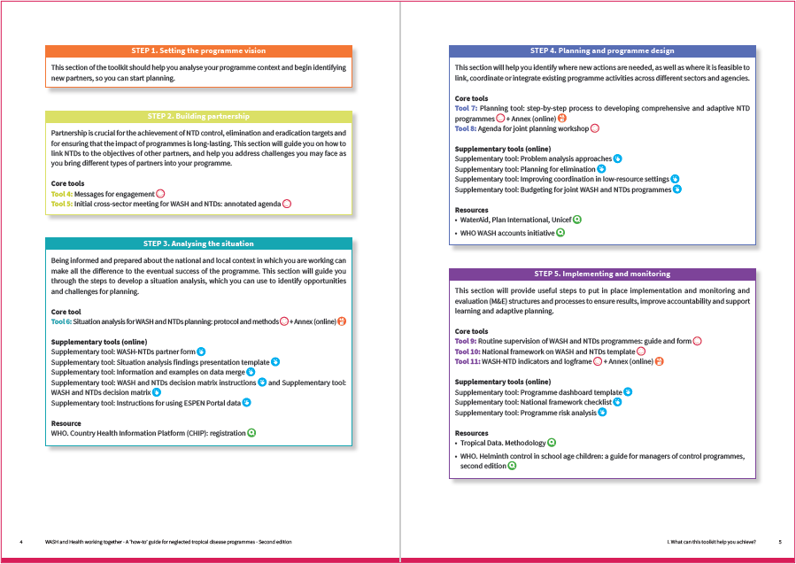
Toolkit at a glance
Supported by 20 > tools and resources
I. Purpose
II. Context
III. Steps to Success
STEP 1. Setting the programme vision
STEP 2. Building partnership
STEP 3. Analysing the situation
STEP 4. Planning and programme design
STEP 5. Implementing and monitoring

Slide 6
STEP 1. Set the programme vision
Setting the programme vision will help you clarify:
What are you trying to achieve with this process? For example: sustained control or elimination of a specific disease/set of diseases.
What will it take? For example: funding, efficient cross-ministerial collaboration, a behaviour change programme, etc.
How is the problem/vision linked to the broader national agenda? For example: achieving and sustaining health outcomes, equity, stated government/ministry policy priorities, etc
Define your overall vision. For example, "achieving elimination to contribute towards the SDGs through an effective multisectoral programme”.
Figure out, why it hasn’t happened yet. What are the barriers to progress?

Slide 7
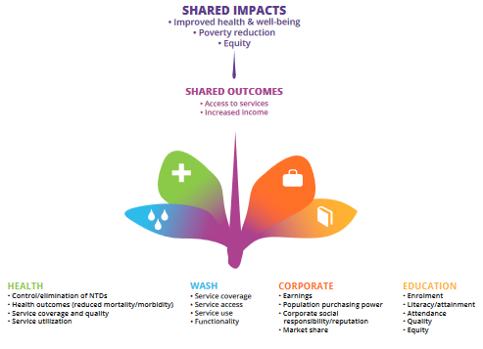
STEP 2. Build partnerships
Why collaborate?
How to collaborate?
Where to start?
1
2
3
Tools
Tool 4: Messages for engagement
Tool 5: Initial cross-sector meeting for WASH and NTDs: annotated agenda

Slide 8
STEP 3. Analyse the situation
Key elements of a situation analysis
1
Conducting and using a situation analysis
A
Demographics
D
WASH access
2
B
Data for decision making
Disease
E
NTD and WASH coordination
Tools
Tool 6: Situation analysis for WASH and NTDs planning: protocol and methods + Annex (online)
C
F
Monitoring mechanisms
Behaviour change initiatives
G
Context for advocacy

Slide 9
Using data for decision making
Data on disease prevalence and WASH access can be used to improve programme targeting and reach.
Decision matrix
Data merge
ESPEN NTD Portal
Three possible approaches to collating and visualizing data for decision making:

Slide 10
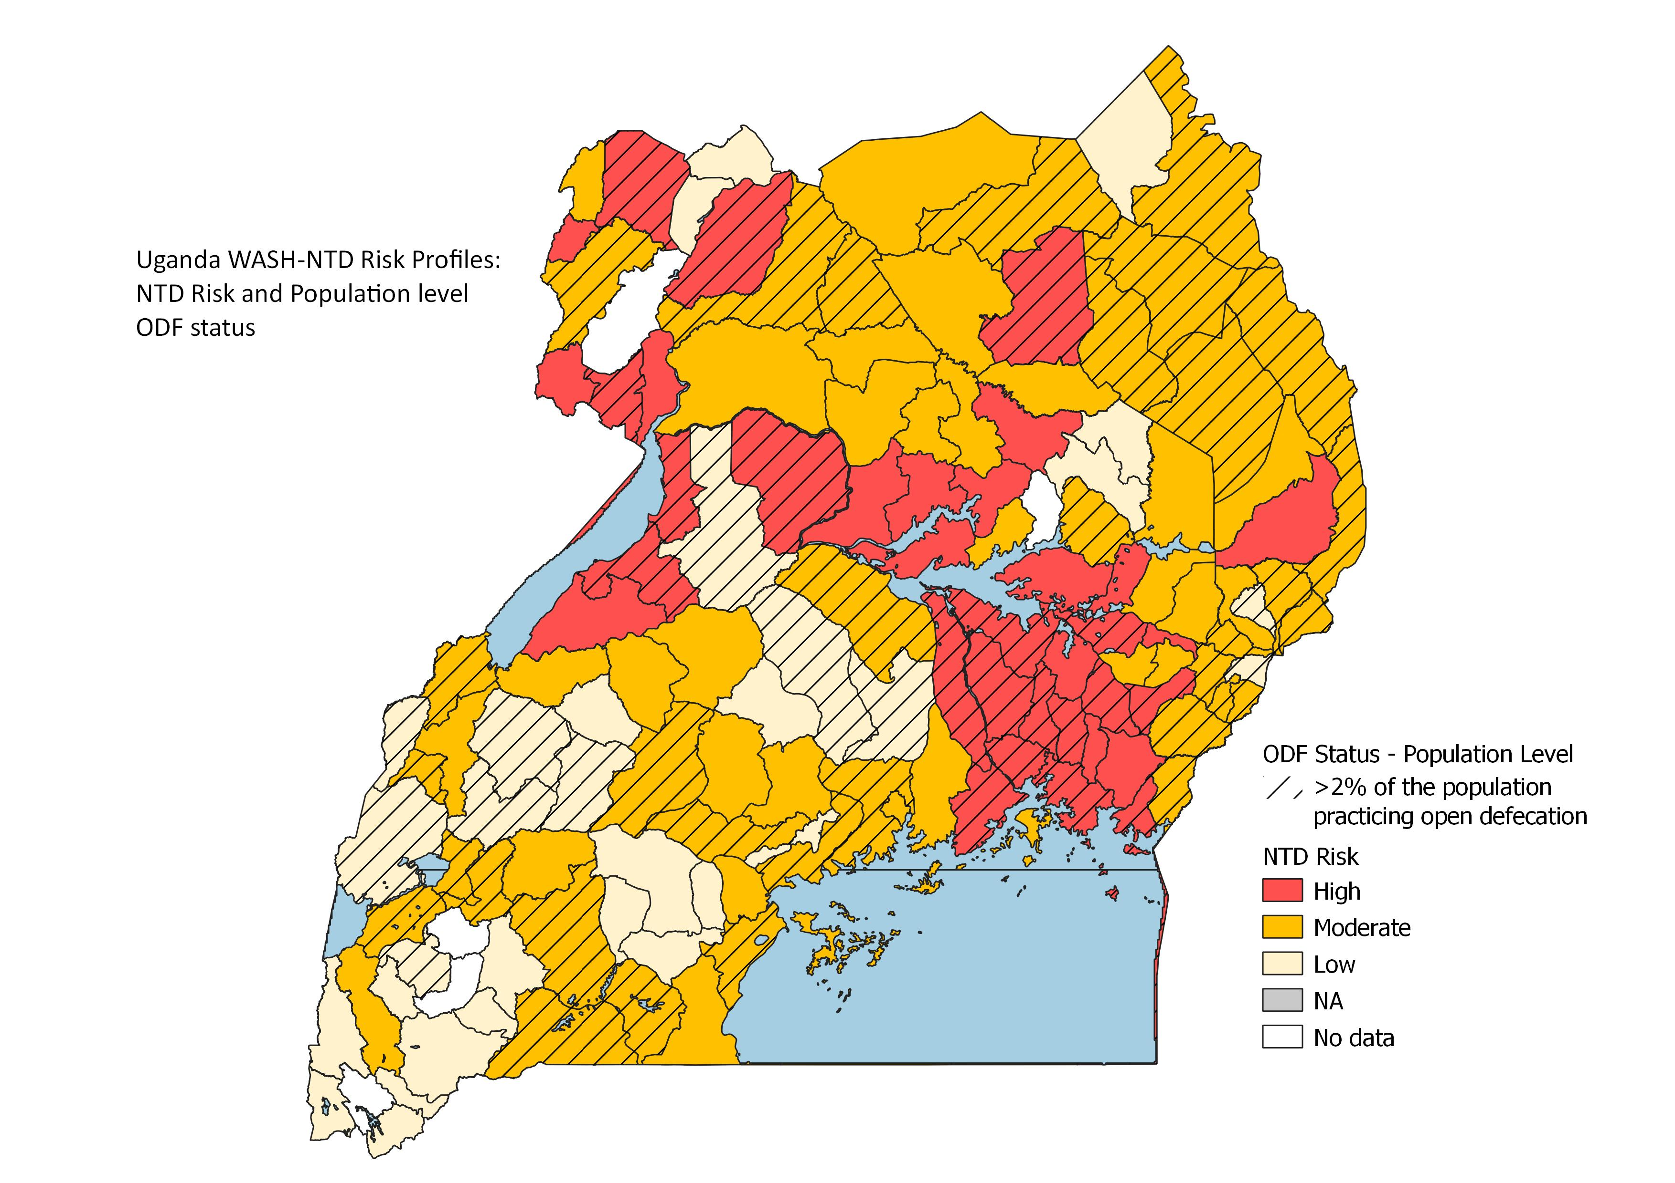
Data for decision making
Option 2: decision matrix
Collate information on NTD endemicity alongside information on access to WASH services, at implementation unit (IU) level.
The Excel-based matrix displays NTD and WASH data in a summarized form to help identify high risk/need districts and prioritize allocation of resources.

Slide 11
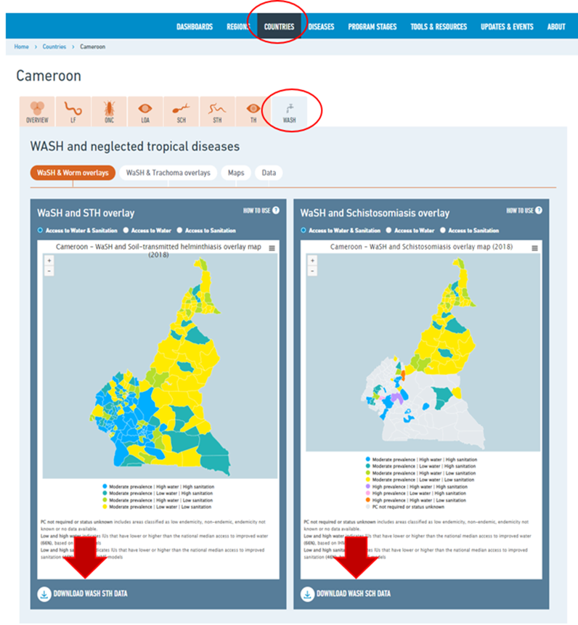
Data for decision making
Option 3. WHO ESPEN portal
The portal is a platform which illustrates, through maps, site and district-level NTD data by disease and country in sub-Saharan Africa.
ESPEN WASH files provide STH and SCH endemicity for the most current year of data, along with the high/low status of access to improved water and access to improved sanitation.
Source: WHO ESPEN portal: https://espen.afro.who.int/

Slide 12
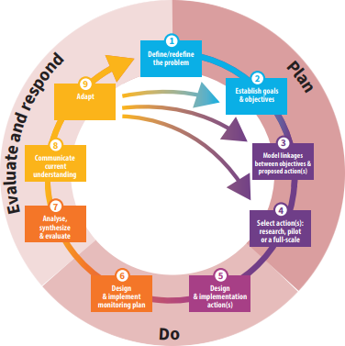
STEP 4. Plan and design the programme
va
Adaptive planning
Tips for developing a successful plan
Long-term policies and strategies
Practical planning steps
Planning and implementation
Financial arrangements
Regular participatory M&E
Dialogue with beneficiaries
Tools
Tool 7: Planning tool: step-by-step process to developing comprehensive and adaptive NTD programmes
Tool 8: Agenda for joint planning workshop
Adaptive Approach to planning

Slide 13
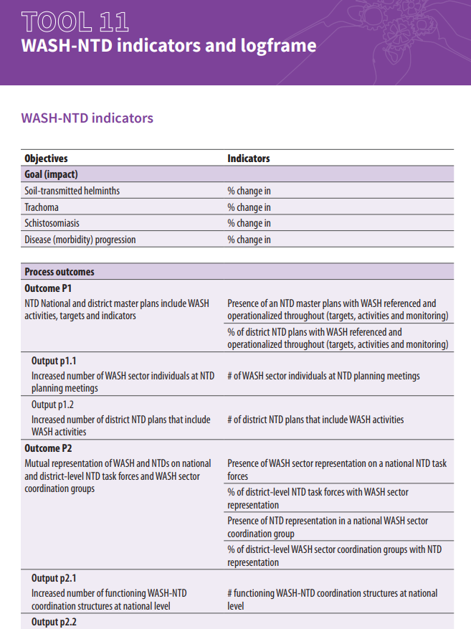
STEP 5. Implement, monitor, evaluate
How to monitor and implement.
Sustaining collaboration through formal guidance such as a national framework on WASH and NTDs.
Getting the monitoring and evaluation framework right.
Tool 9: Routine supervision of WASH and NTDs programmes: guide and form
Tool 10: National framework on WASH and NTDs template
Tool 11: WASH-NTD indicators and logframe

Slide 14
Ethiopia
WASH-NTD collaboration at national and district levels and adaptation and implementation of toolkit
Credit: Ethiopia Federal Ministry of Health, NALA Foundation, Sightsavers International, the END Fund.
WHO
Photo credit: Merck Group & NALA Foundation/Marcus Perkins

Slide 15
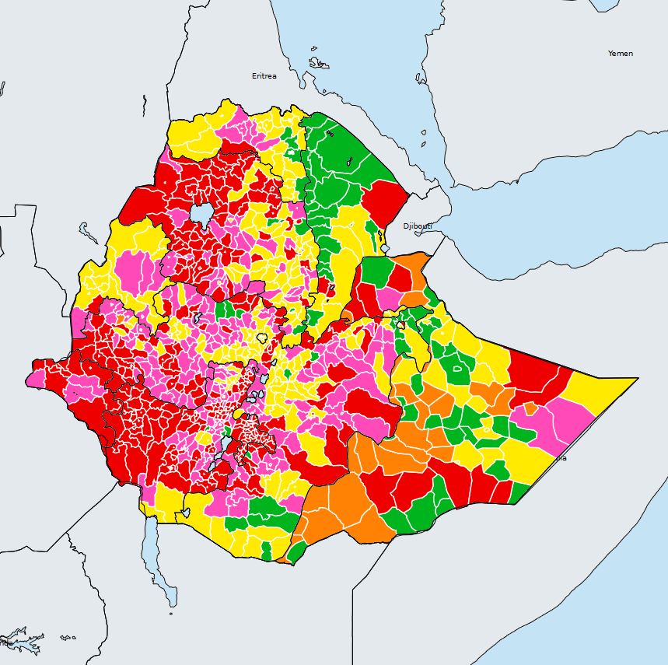
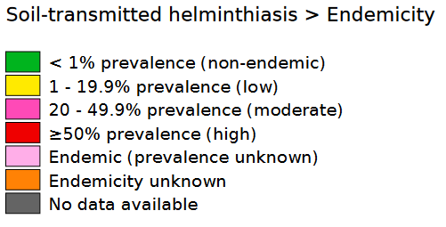
39%
of implementation units (IUs) have STH prevalence ≥50%
Background
High endemicity of NTDs, many strongly linked to unsafe WASH.
Control relies on preventive chemotherapy, but reinfection occurs rapidly.
Access to adequate WASH services remains a challenge: >80% population practice open defecation or use unimproved sanitation facilities in 2020¹.
Limited platforms and resources available to bring WASH, NTD and key sectors together in a structured way.
Ethiopia (2021)
Status of Soil-transmitted helminthiasis elimination
¹Source: Progress on household drinking water, sanitation and hygiene 2000-2020: five years into the SDGs. World Health Organization & United Nations Children's Fund (‎UNICEF)‎, 2021‎.
Source: WHO ESPEN portal https://espen.afro.who.int/countries/ethiopia

Slide 16
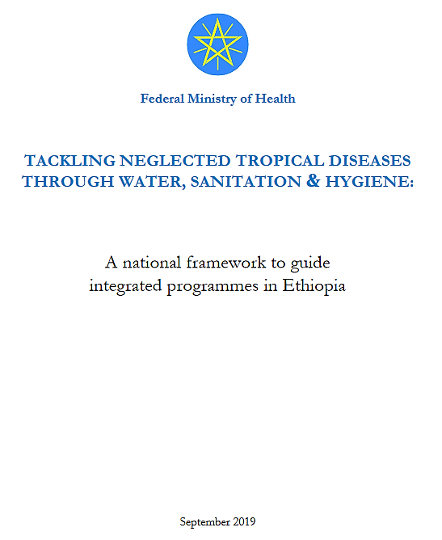
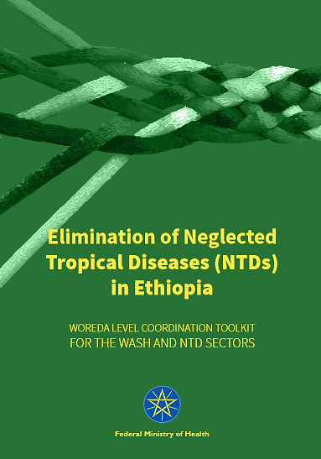
What was done?
Ethiopia Federal Ministry of Health launched activities to strengthen collaboration at all levels:
Ethiopia Federal Ministry of Health launched activities to strengthen collaboration at all levels
National level WASH-NTD technical working group formed
Workshops with decision makers
Supportive policies, guidelines and tools
Situation analysis
Inter-sectoral coordination framework and district level toolkit
Consultation and stakeholder mapping

Slide 17
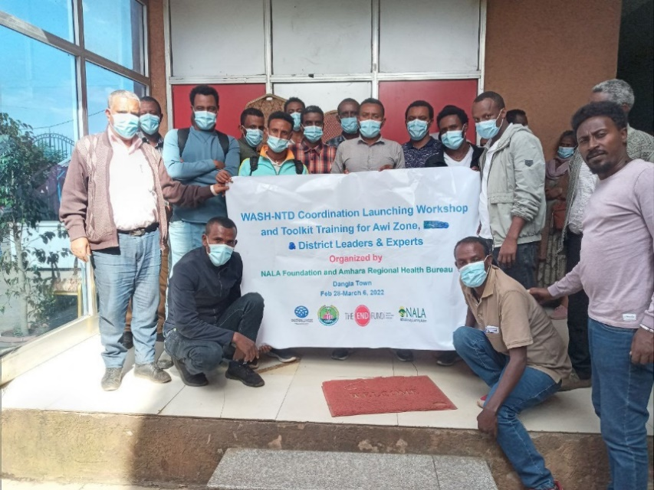
What was done?
Pilot (Oct 2018-Feb 2020) in 99 districts across five regions
01
Testing of district-level toolkit
03
Delivery of training courses
02
Follow up and joint supportive supervision
04
Formation of WASH-NTD Task Forces and Technical Working Groups
Photo credit: NALA Foundation

Slide 18
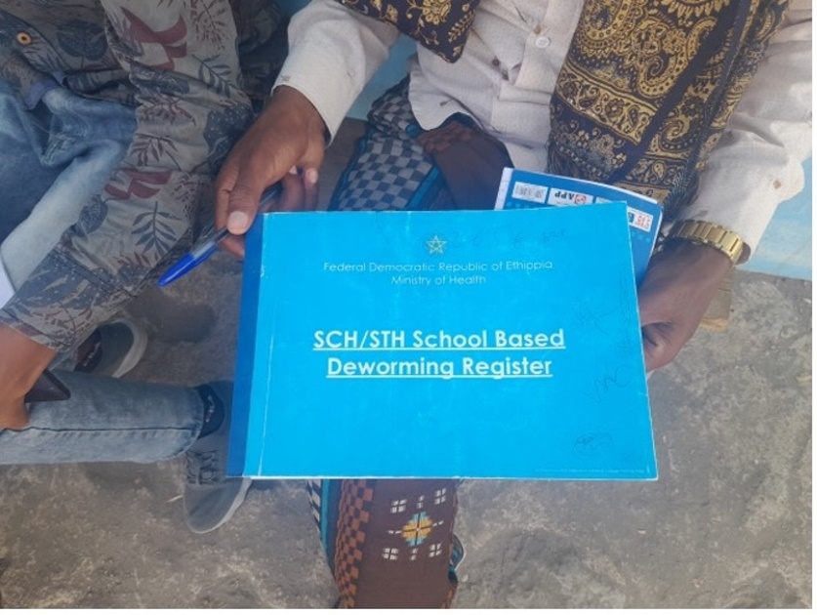
What was done?
Implementation phase (2020-present) country wide with progressive roll out in each region:
01
Roll out of the toolkit in nine regions and more than 300 districts
02
Launch of online course for multisectoral coordination
Photo credit: NALA Foundation
03
Launch of second online course for joint data sharing

Slide 19
Key results
In three out of five zones, more than 80 percent of the districts launched coordination platforms and prepared WASH-NTD action plans.
Budget allocated for WASH activities and infrastructure in high endemicity districts
District
Level
Impacts
Routine environmental hygiene campaigns conducted in schools
NTD indicators included in regular school monitoring checklists
Strong linkage with One WASH National Program
Latrine utilization improved following joint activities & Kebeles pronounced ODF

Slide 20
Key lessons
Close follow-up and supervision was essential to sustain activities.
Commitment of district administrator – who is mandated to approve budgets and prioritize initiatives - plays a key role in programme success.
Involvement of NGO partners -opportunity for technical and financial support.
Training of sector heads for strong leadership backing and training of technical experts responsible for work on the ground are both essential.

Slide 21
In summary
Partnership across sectors is essential to control many diseases including vector borne diseases like malaria.
Before involving others:
Identify what you are trying to achieve.
Make sure you include everyone from the beginning.
Be clear about the reasons for engaging each stakeholder.
A situation analysis is a first step towards developing a joint programme approach
Use WASH and disease data to highlight inequalities and target investments.
Collaboration and coordination involves changes to established ways of working - adopting an adaptive approach is important.
Monitoring and evaluation is key to ensure good programme results.

Slide 22
Thank you!

